Slide 1
Physiology of Coordination
Mechanisms in
Resting Membrane Potentials
ABAIDULLAH COLLEGE PAKPATTAN

Slide 2
Membrane Potentials
A. The body as a whole is electrically neutral
B. All of the cells of body have an electrical potential across their membrane (Voltage difference) known as the membrane potential
C. Membrane potentials develop because of differing ion concentrations between the inside and outside of the cell

Slide 3
Membrane Potentials
Current - flow of electrical charges from one point to another.
1. Like charges repel each other, unlike attract
2. Ions tend to move from areas of greater concentration to areas of lower concentration
3. Movement of a positive ion from one side of a membrane to the other implies a negative charge is left behind

Slide 4
Membrane Potentials
Membrane potential refers to the difference in electrical charge across the cell membrane. It results from the unequal distribution of ions (such as sodium, potassium, chloride, and others) inside and outside the cell.
This electrical charge difference creates a potential energy across the membrane, which is crucial for various cellular processes like nerve signal transmission, muscle contraction, and maintaining homeostasis.

Slide 5
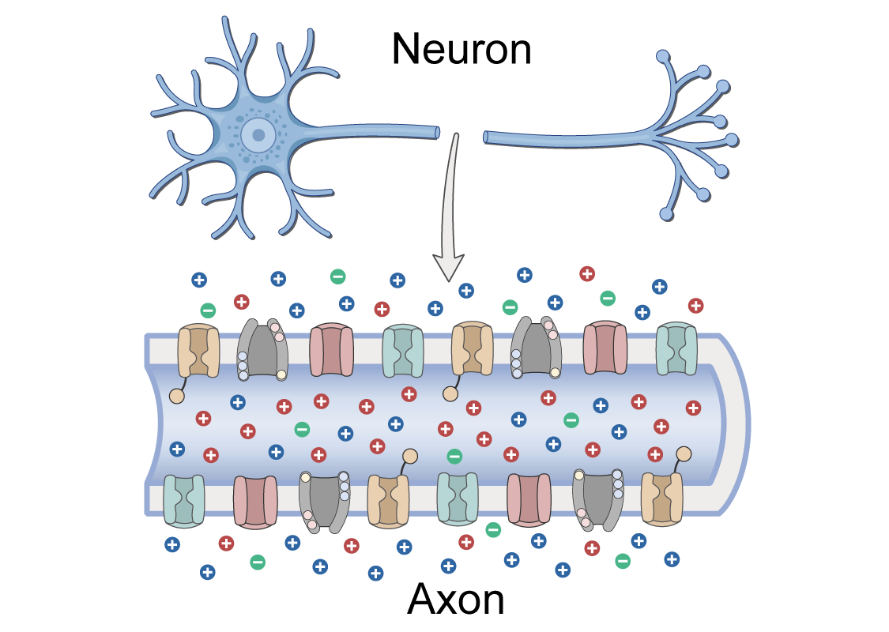
Membrane Potentials

Slide 6
RESTING Membrane Potentials
The resting membrane potential is the baseline electrical charge across the membrane when the cell is at rest, typically around -70 millivolts (mV) for many cells.
When a cell becomes excited (such as in neurons), this potential can change, leading to action potentials and the propagation of electrical signals.

Slide 7
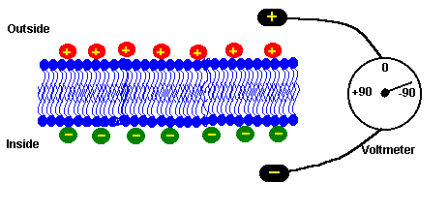
RESTING Membrane Potentials

Slide 8
Membrane Potentials

Slide 9
Electrogenic Ion Pump
An electrogenic ion pump is a type of protein pump that actively transports ions across the cell membrane, creating a net change in the electrical charge across the membrane.
These pumps contribute to the generation and maintenance of the membrane potential by moving ions in such a way that they affect the cell’s overall electrical balance.
One of the best-known examples of an electrogenic ion pump is the sodium-potassium pump (Na+/K+ pump).

Slide 10
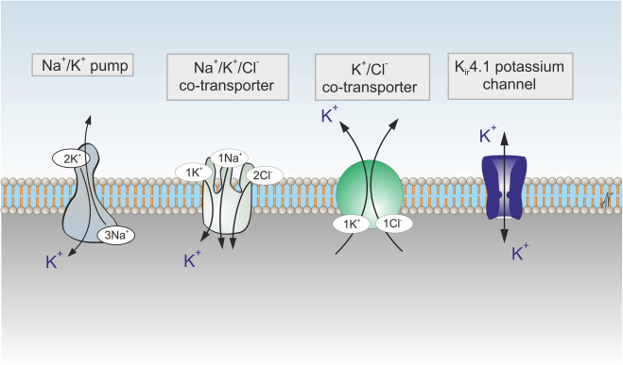

Slide 11
Sodium Potassium Pump
The pump moves 3 sodium (Na+) ions out of the cell and 2 potassium (K+) ions into the cell against their concentration gradients, using energy from ATP (adenosine triphosphate). This process is called active transport.
As a result, the inside of the cell becomes more negative relative to the outside, contributing to the resting membrane potential (usually around -70 mV in many cells).

Slide 12
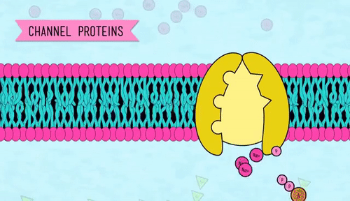
Outside Neuron (More Na+ Ions)
Inside Neuron (More K+ Ions)

Slide 13
Electrogenic Ion Pump
Additionally, the pump helps maintain the concentration gradients of Na+ and K+, which are essential for cellular processes like nerve signaling and muscle contraction.
The term "electrogenic" specifically refers to the fact that this pump creates a direct contribution to the membrane potential by moving different numbers of positively charged ions in and out of the cell.
In the case of the Na+/K+ pump, it is electrogenic because it moves more sodium ions out (3) than potassium ions in (2), creating a small net negative charge inside the cell.

Slide 14
Donnan Equilibrium
Donnan's equilibrium refers to the distribution of ions across a semi-permeable membrane that separates two solutions, where one or more ions cannot freely pass through the membrane.
This situation results in a specific balance of ion concentrations and electric potentials on either side of the membrane.
It is named after the British chemist Frederick Donnan, who described the phenomenon in the early 20th century.

Slide 15
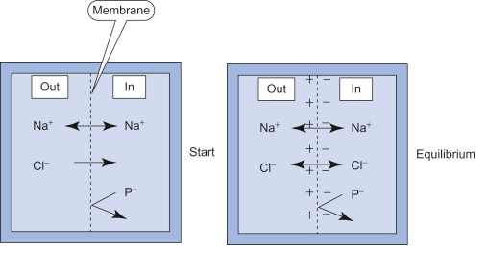

Slide 16
Donnan Equilibrium
Semi-permeable membrane: A membrane that allows certain ions or molecules to pass through but restricts others.
Non-permeable ions: Some ions (such as large proteins or other charged particles) are too large to pass through the membrane, while smaller ions (like Na+, K+, Cl-) can move freely.
Electrochemical equilibrium: The movement of ions across the membrane creates an electric potential difference (voltage) and a concentration gradient (difference in ion concentration).

Slide 17
How Donnan's Equilibrium Works?
When a semi-permeable membrane separates two solutions, one of which contains ions that cannot pass through the membrane (such as large proteins), the free ions (those that can pass through) will tend to move in a way that balances out their concentrations on both sides of the membrane.
However, the ions that cannot pass through will cause a distribution imbalance. This imbalance results in a diffusion of ions across the membrane, which creates both a concentration gradient and an electrical potential difference.

Slide 18
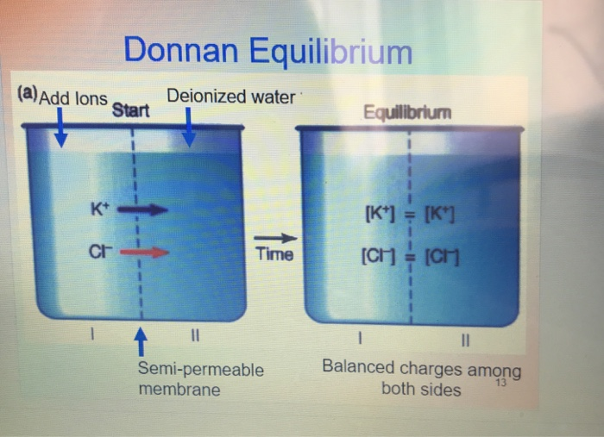

Slide 19
Example of Donnan’s Equilibrium
A classic example is the situation in cells where large proteins (which cannot pass through the cell membrane) are confined inside. These proteins attract positively charged ions like sodium (Na+) to the inside of the cell, leading to an imbalance of ion concentrations across the membrane.
As a result, there is both an osmotic pressure difference and an electrical potential across the membrane, which influences the movement of water and ions, contributing to cellular functions.

Slide 20
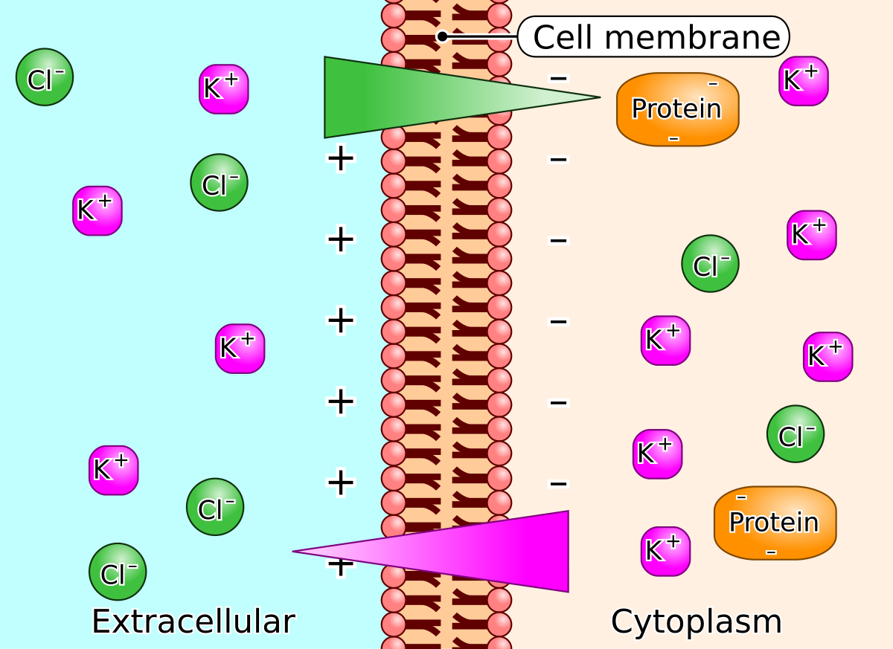

Slide 21
Summary of Donnan’s Equilibrium
Donnan's equilibrium describes how ions distribute across a membrane when some ions are permeable and others are not, creating a balance between chemical gradients and electric potentials.
This concept is important in various biological processes, such as the maintenance of cell volume, maintaining membrane potential and the regulation of osmotic pressure across membranes.

Slide 22
Action Membrane Potential
Action potentials are rapid, transient changes in the electrical potential across the membrane of excitable cells like neurons, muscle cells, and some endocrine cells.
These changes are essential for functions such as nerve signal transmission, muscle contraction, and hormonal release.
The ionic mechanisms involved in action potentials are driven by the movement of ions across the cell membrane, facilitated by ion channels and pumps.

Slide 23
1. Resting Membrane Potential:
Before an action potential occurs, the cell is at its resting membrane potential, typically around -70 mV in neurons. At this state:
The inside of the cell is more negative compared to the outside due to the unequal distribution of ions.
This is maintained by the sodium-potassium pump (Na+/K+ pump), which pumps 3 Na+ ions out of the cell for every 2 K+ ions pumped in.
Additionally, leak channels allow some K+ to move out of the cell, contributing to the negative resting potential.

Slide 24
2. Depolarization
When a stimulus is strong enough to bring the membrane potential to a certain threshold (usually around -55 mV), it triggers the action potential. This is known as the threshold potential.
Voltage-gated sodium channels open rapidly in response to the depolarization.
Sodium ions (Na+) rush into the cell because their concentration is higher outside the cell and they are attracted to the negative interior.
The influx of Na+ ions causes the membrane potential to become more positive, leading to depolarization (the membrane potential moves toward +30 to +40 mV).

Slide 25
3. Repolarization
After the membrane potential reaches its peak, the cell starts to return to its resting state.
Voltage-gated sodium channels close automatically, stopping the influx of Na+ ions.
At the same time, voltage-gated potassium channels open. Potassium ions (K+) are in higher concentration inside the cell, so they move out of the cell.
The efflux of K+ ions causes the membrane potential to become more negative, or repolarized, returning toward the resting membrane potential.

Slide 26
4. Hyperpolarization
As K+ ions continue to leave the cell, the membrane potential temporarily becomes even more negative than the resting membrane potential. This is called hyperpolarization.
This occurs because potassium channels remain open for a short period after the membrane potential reaches its resting value, allowing more K+ to exit the cell than needed.

Slide 27
5. Restoration of Resting Potential
The sodium-potassium pump (Na+/K+ pump) works continuously to restore the proper concentrations of Na+ and K+ across the membrane.
The cell eventually returns to its resting membrane potential, ready to fire another action potential if needed.

Slide 28
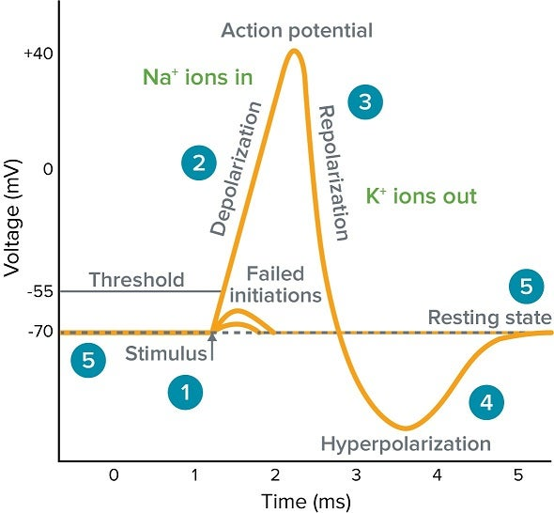

Slide 29
Ionic Mechanisms in Each Phase of the Action Potential
Resting State:
High concentrations of Na+ outside the cell and K+ inside the cell.
The membrane is mostly impermeable to Na+ (except for some leak channels) and permeable to K+ (via leak channels).
Depolarization:
Voltage-gated Na+ channels open, allowing Na+ ions to rush into the cell, making the inside more positive.

Slide 30
Repolarization:
Voltage-gated Na+ channels close and stop the entry of Na+.
Voltage-gated K+ channels open, allowing K+ ions to leave the cell, making the inside more negative.
Hyperpolarization:
The K+ channels stay open longer than needed, causing an excess efflux of K+, making the membrane potential more negative than the resting potential.
Return to Resting Potential:
The Na+/K+ pump works to move Na+ out and K+ in to restore the proper concentration gradients.

Slide 31
The Importance of Ion Channels in Action Potentials
Voltage-gated ion channels (Na+ and K+ channels) are crucial for the rapid and controlled movement of ions across the membrane during an action potential.
Ligand-gated channels (in some cells) or mechanically-gated channels (in sensory neurons) can also initiate action potentials in response to stimuli.

Slide 32
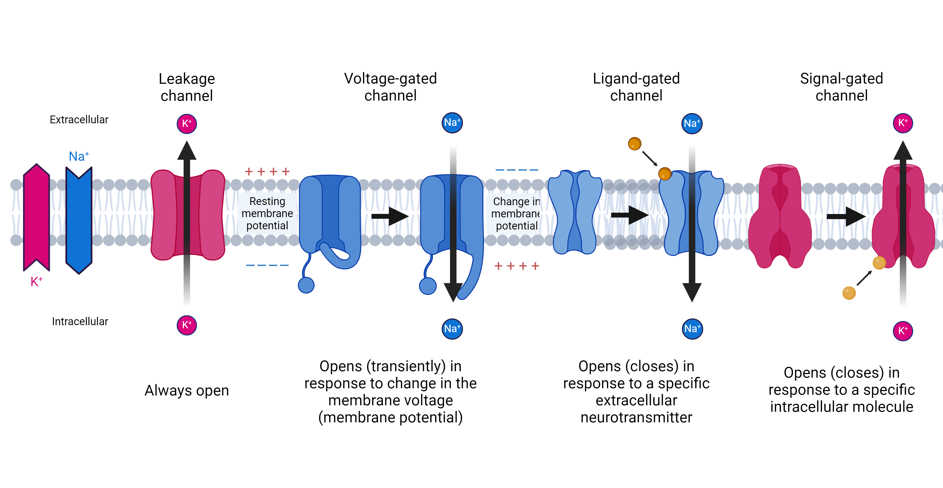

Slide 33
Propagation of Action Potentials
Once an action potential is initiated, it travels along the axon (in neurons) or muscle fiber (in muscle cells) by a process called saltatory conduction in myelinated axons (where the action potential "jumps" between nodes of Ranvier) or continuous conduction in unmyelinated fibers.
The precise control of these ionic movements is vital for the rapid transmission of signals and proper cellular function, such as muscle contraction or nerve signal transmission.

Slide 34
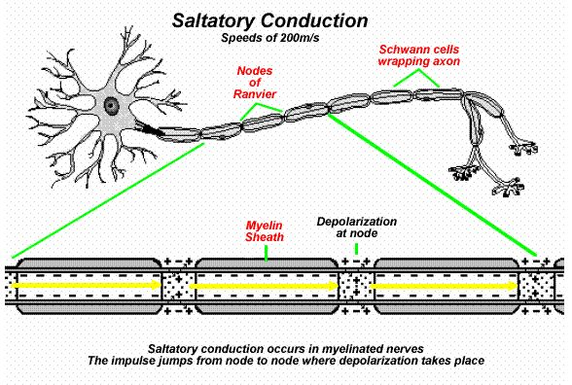

Slide 35
THANK YOU

