Slide 1
Photoreception
Subject: Physiology of Coordination
(BS Zoology 6th Semester)
By: Shozab Seemab Khan
(PhD Zoology Scholar)
ABAIDULLAH COLLEGE PAKPATTAN

Slide 2
What is Photoreception?
Photoreception is the biological process by which organisms detect and respond to light stimuli.
This capability is fundamental for vision in animals and for various light-mediated responses in plants and microorganisms.
In animals, photoreception is primarily mediated by photoreceptor cells located in specialized sensory organs like the retina of the eye.

Slide 3
What are Photoreceptors?
Photoreceptors are specialized types of neural cells that can absorb photons (light particles) and convert them into electrical signals through a process called phototransduction.
These signals are then processed by the nervous system to form visual perception.

Slide 4
Photoreceptors: Types
There are two primary types of photoreceptor cells in vertebrates:
1. Rods:
Sensitive to low light (scotopic vision), not color-sensitive.
2. Cones:
Responsible for color vision and high visual acuity (photopic vision).
Notes:
Scotopic vision is the eye's ability to see in low-light conditions, primarily using rod cells that detect light but not color.
Photopic vision is the eye's ability to see in bright light conditions, primarily using cone cells that detect color and fine detail.

Slide 5
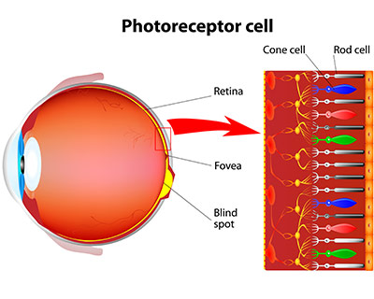
Notes:
The fovea is the central part of the retina responsible for sharp central vision and high visual acuity.

Slide 6
Ultrastructure of Photoreceptors
The ultrastructure of photoreceptor cells refers to the detailed internal organization observable under an electron microscope. Both rods and cones share a basic structure but differ in shape and some functional components.
Main Components:
1. Outer Segment (OS):
2. Connecting Cilium:
3. Inner Segment (IS):
4. Cell Body (Nucleus):
5. Synaptic Terminal

Slide 7
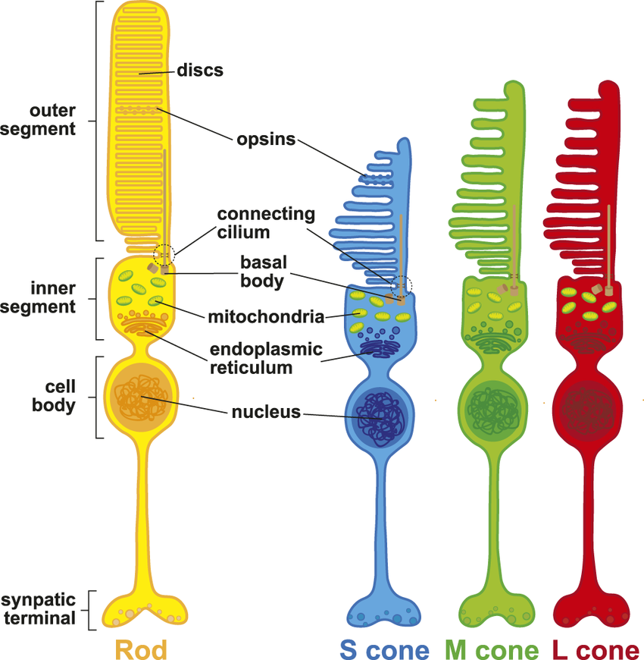

Slide 8
1. Outer Segment (OS):
Contains stacked membrane discs embedded with photopigments (e.g., rhodopsin in rods, opsins in cones).
These discs are the site of phototransduction.
Rods have free-floating discs, while cones have discs continuous with the plasma membrane.

Slide 9
2. Connecting Cilium:
A narrow bridge connecting the outer segment to the inner segment.
Functions as a transport channel, moving proteins and materials between segments.
Structurally similar to a modified cilium.

Slide 10
3. Inner Segment (IS):
Rich in mitochondria, endoplasmic reticulum, and Golgi apparatus. Provides metabolic support and synthesizes proteins and photopigments.
Divided into:
Ellipsoid Region:
Densely packed with mitochondria.
Myoid Region:
Contains ribosomes and protein synthesis machinery.

Slide 11
4. Cell Body (Nucleus):
Contains the nucleus and other organelles.
Located below the inner segment.
Responsible for gene expression and nuclear regulation.

Slide 12
5. Synaptic Terminal
(Pedicle in cones, Spherule in rods):
Forms synapses with bipolar and horizontal cells.
Contains synaptic vesicles for neurotransmitter release (mainly glutamate).
Adjusts neurotransmitter release based on light conditions (tonic release in the dark, reduced in light).
Notes:
"Tonic release in the dark" refers to the continuous release of neurotransmitters (mainly glutamate) by photoreceptor cells (rods and cones) when they are not stimulated by light.

Slide 13
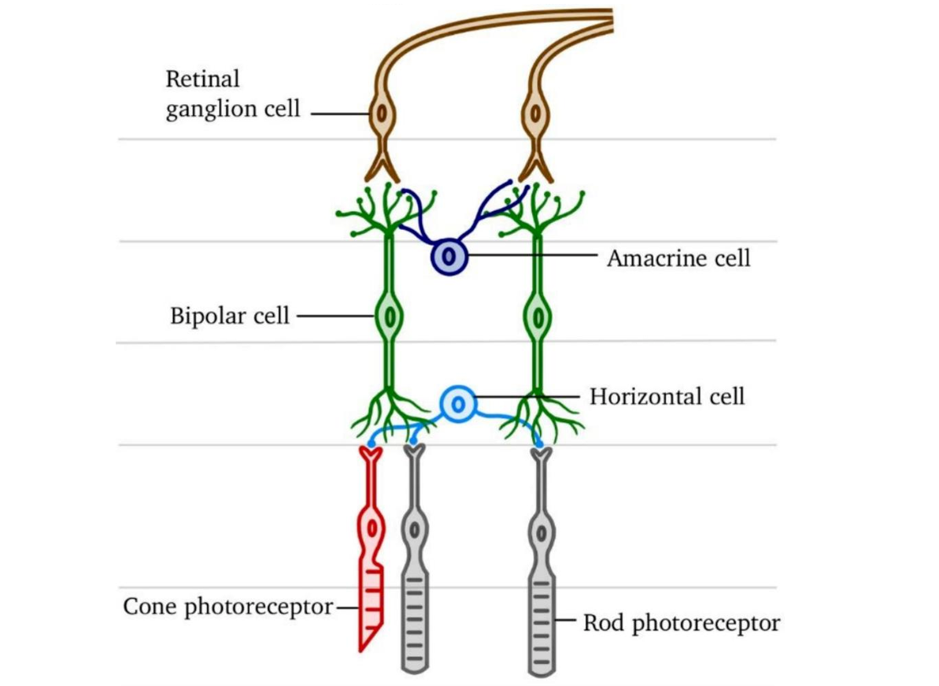

Slide 14
Photochemistry of Photoreceptors:
Photochemistry refers to the chemical changes that occur in photoreceptor cells when they absorb light (photons).
The key molecule in this process is the photopigment, primarily rhodopsin in rods and opsins in cones.
Key Concepts in Photochemistry:
Photopigments are made up of two parts:
Opsin (a protein)
Retinal (a light-absorbing chromophore, derived from Vitamin A)

Slide 15
Photochemical Reaction
1. In darkness, 11-cis-retinal is bound to opsin.
2. When a photon hits the photopigment:
11-cis-retinal isomerizes to all-trans-retinal.
This isomerization causes a conformational change in opsin, converting rhodopsin into metarhodopsin II (active form).

Slide 16
Photochemical Reaction
3. Metarhodopsin II initiates the phototransduction cascade.
4. After activation, all-trans-retinal is:
Released from opsin,
Converted back to 11-cis-retinal (via the retinoid cycle),
Rebound to opsin to regenerate rhodopsin.

Slide 17
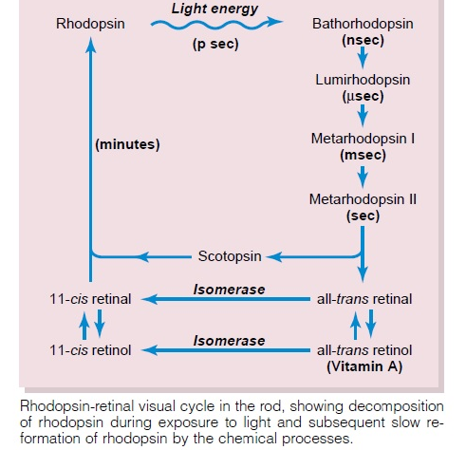

Slide 18
Phototransduction
Phototransduction is the biochemical process by which light is converted into an electrical signal in photoreceptors.
Step-by-Step Mechanism:
In Darkness:
cGMP levels are high.
cGMP-gated Na⁺ and Ca²⁺ channels are open, causing an influx of positive ions.
The cell is depolarized (around −40 mV).
Continuous release of the neurotransmitter glutamate at the synapse.

Slide 19
Phototransduction
In Light:
1. Light hits rhodopsin → activates metarhodopsin II.
2. Activates the G-protein transducin.
3. Transducin activates phosphodiesterase (PDE).
4. PDE hydrolyzes cGMP → cGMP levels drop.
5. cGMP-gated channels close, reducing Na⁺/Ca²⁺ influx.

Slide 20
Phototransduction
6. The cell hyperpolarizes (up to −70 mV).
7. Decreased glutamate release → this change in neurotransmission is detected by downstream neurons.
Outcome:
The change in membrane potential signals the presence of light to the bipolar and ganglion cells.

Slide 21
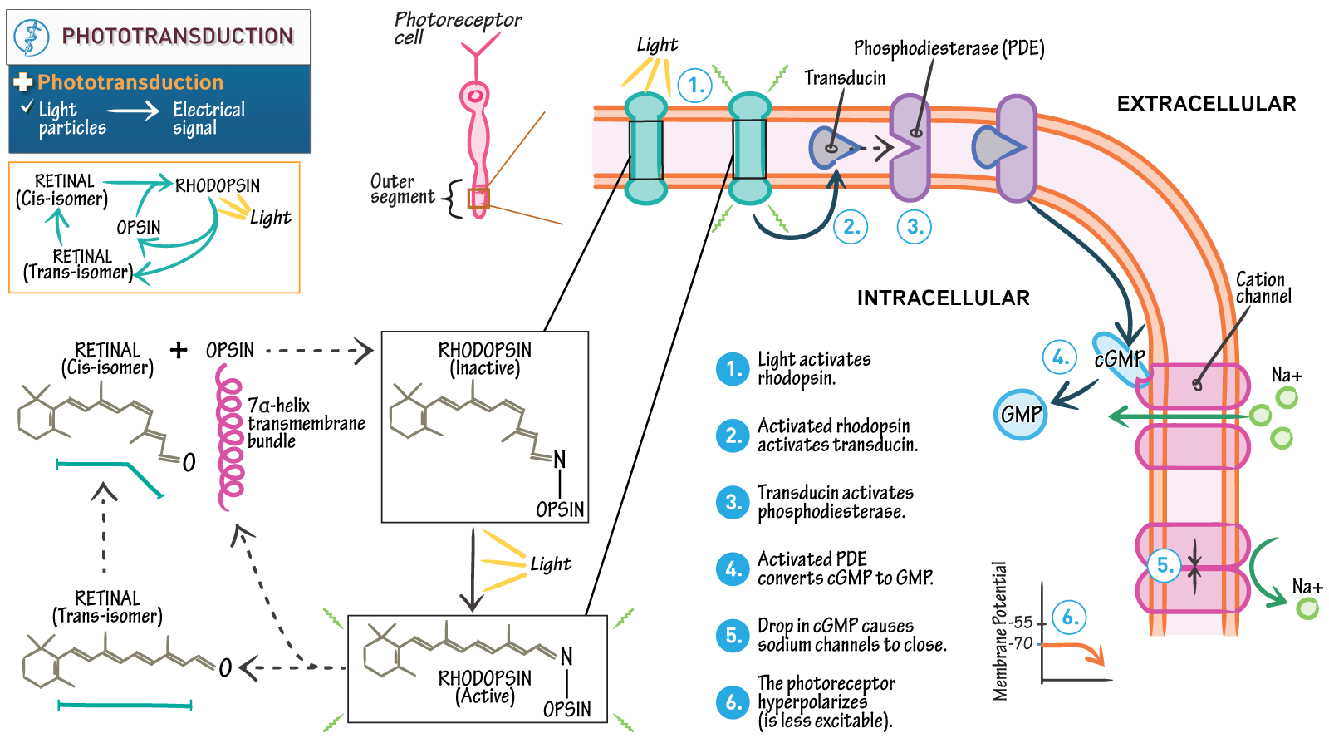

Slide 22
Physiological Basis of Color Vision
Color vision is primarily mediated by cone photoreceptors, which are of three types based on their opsin protein and spectral sensitivity.
Types of Cone Cells
Cone Type | Wavelength | Peak Wavelength | Perceived Color
S-cones | Short | ~420 nm | Blue
M-cones | Medium | ~534 nm | Green
L-cones | Long | ~564 nm | Red

Slide 24
Mechanism of Color Vision
1. Different cones are stimulated by different wavelengths of light.
2. The relative activation of S, M, and L cones is processed by the retina and brain to perceive color.
Example: Yellow light (~580 nm) stimulates both L- and M-cones, but not S-cones.
3. Signals are processed by:
Horizontal and bipolar cells (in retina): do early contrast and edge detection.
Ganglion cells (especially opponent-process cells): encode color opponency.
Visual cortex (V1, V2, V4): processes complex color perception.

Slide 25
Color Opponency:
Neurons compare input from different types of cones to detect color contrasts.
Opponent pairs:
Red vs. Green (L vs. M cone signals)
Blue vs. Yellow (S vs. [L+M] cone signals)
Black vs. White (light intensity)
This opponent processing enhances color contrast and sharpness.

Slide 26
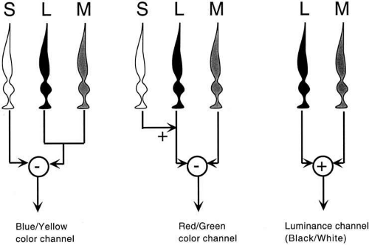

Slide 27
Color Blindness
Occurs due to:
Absence or malfunction of one or more types of cones.
Most common: red-green color blindness (M or L cone defect).

Slide 28
Summary Table
Aspect | Description
Photochemistry | Light triggers isomerization of retinal in opsin, activating photopigments
Phototransduction | Light-induced molecular cascade reduces cGMP → closes ion channels → hyperpolarization
Color Vision | Achieved via differential stimulation of three cone types (S, M, L) and neural processing

Slide 29
THANK YOU

