Slide 1
Presynaptic Inhibition
Subject: Physiology of Coordination
(BS Zoology 6th Semester)
By: Shozab Seemab Khan
(PhD Zoology Scholar)
ABAIDULLAH COLLEGE PAKPATTAN

Slide 2
Presynaptic Inhibition
🌐 What is it: Presynaptic inhibition is a type of neural regulation where the activity of a presynaptic neuron is decreased by the action of another neuron. This results in reduced neurotransmitter release into the synaptic cleft.
🧠 How it works: A third neuron (interneuron) forms an axo-axonic synapse with the presynaptic terminal of a neuron.
This interneuron releases an inhibitory neurotransmitter, typically GABA (gamma-aminobutyric acid).

Slide 3
Presynaptic Inhibition
GABA binds to receptors on the axon terminal of the presynaptic neuron.
This causes chloride (Cl⁻) influx or potassium (K⁺) efflux, hyperpolarizing the terminal and/or inhibiting voltage-gated calcium channels.
Since calcium influx is essential for vesicle fusion and neurotransmitter release, the inhibition of calcium entry results in less neurotransmitter being released.

Slide 4
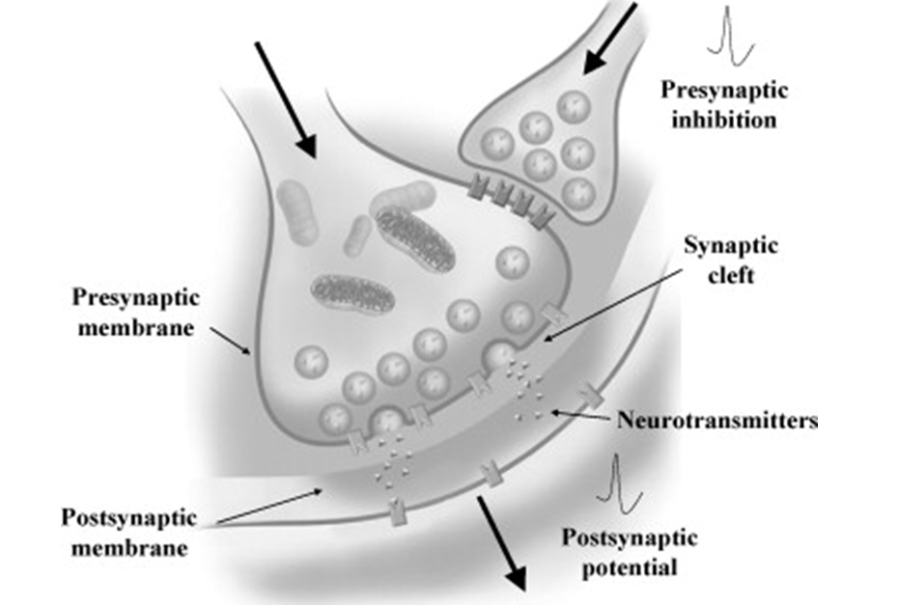

Slide 5
Presynaptic Inhibition
🔍 Functional Significance:
Selective filtering of signals:
It helps prioritize certain pathways over others.
Protection against excessive excitation
(e.g., in epilepsy).
Motor control:
Important in fine-tuning movement via spinal cord interneurons.

Slide 6
Integration at Synapses
🌐 What is it?
Neurons receive thousands of excitatory and inhibitory inputs.
Synaptic integration is the process by which a neuron combines all these inputs to decide whether to generate an action potential or not.
📘 Types of Integration:
a) Spatial Summation:
b) Temporal Summation:

Slide 7
a) Spatial Summation:
Multiple presynaptic neurons fire simultaneously at different synapses on the same postsynaptic neuron.
The effects of these inputs add together.
If the combined input reaches threshold at the axon hillock, an action potential is fired.

Slide 8
b) Temporal Summation:
A single presynaptic neuron fires repeatedly in rapid succession.
Each EPSP (excitatory postsynaptic potential) adds to the previous one before it decays.
This can push the membrane potential to the threshold.

Slide 9
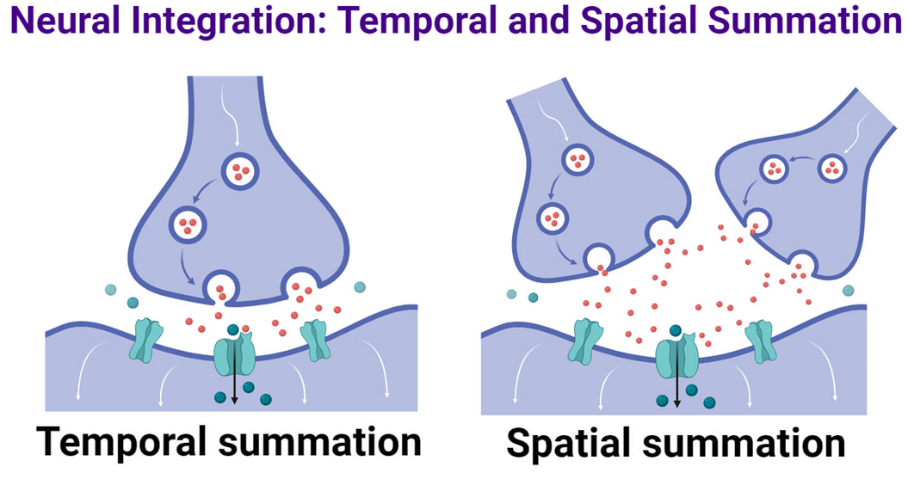

Slide 10
🔍 Functional Significance:
Allows the nervous system to process complex patterns of inputs.
Helps in decision making at the cellular level — determining whether to "fire" or stay silent.
Essential for reflexes, sensory processing, and cognitive functions like learning and memory.

Slide 11
SSRIs (Serotonin-Specific Reuptake Inhibitors)
🌐 What are SSRIs?
SSRIs are a class of antidepressant medications that enhance serotonin signaling in the brain.
🧠 Mechanism of Action:
Normally, after serotonin is released into the synaptic cleft, it's quickly reabsorbed by the serotonin transporter (SERT) on the presynaptic membrane.

Slide 12
SSRIs (Serotonin-Specific Reuptake Inhibitors)
SSRIs inhibit this transporter, blocking reuptake of serotonin.
This increases the concentration of serotonin in the synaptic cleft and prolongs its action on postsynaptic receptors.
💡 Facilitation:
By maintaining higher serotonin levels in the cleft, SSRIs facilitate ongoing synaptic transmission.
Over time, this enhances serotonergic tone, which helps correct mood imbalances.

Slide 13
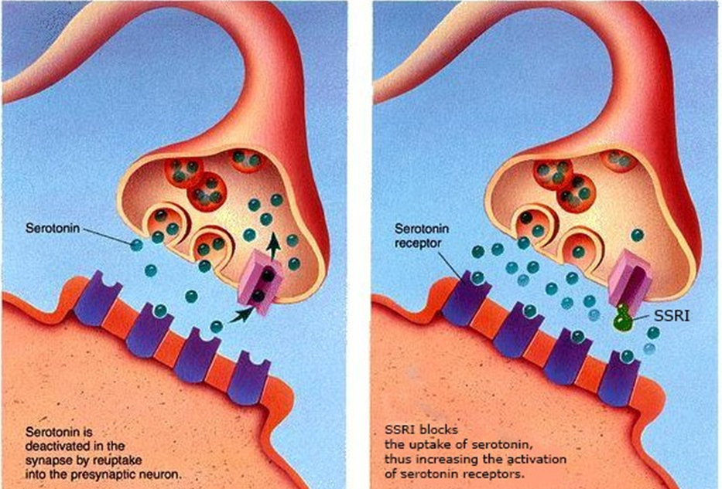

Slide 14
🔍 Clinical Significance:
Used in the treatment of major depressive disorder, anxiety disorders, OCD (Obsessive-Compulsive-Disorder), PTSD (Post-Traumatic Stress Disorder), etc.
Common SSRIs:
Fluoxetine (Prozac), Sertraline (Zoloft), Citalopram (Celexa), Escitalopram (Lexapro).

Slide 15
Post-Tetanic Potentiation (PTP)
🌐 What is it? PTP is a form of short-term synaptic plasticity where synaptic strength increases after a high-frequency (tetanic) stimulation.
🧠 Mechanism: High-frequency stimulation causes a large influx of calcium into the presynaptic terminal.
After the tetanic burst ends, calcium levels remain elevated for a short time.
Elevated calcium enhances neurotransmitter release with each subsequent action potential.
Result: The postsynaptic response is stronger than usual, even without ongoing high-frequency input.

Slide 16
Post-Tetanic Potentiation (PTP)
⏳ Duration:
Lasts for seconds to minutes (short-term memory scale).
🔍 Functional Significance:
Enhances signal transmission temporarily, especially during repetitive use.
Related to short-term memory, synaptic learning, and increased efficiency of neural circuits.
Often studied in the hippocampus — key area for learning.

Slide 17
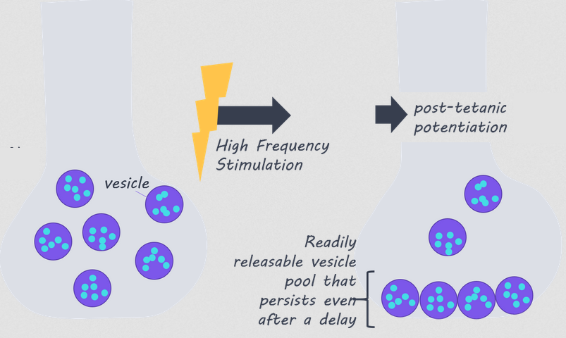

Slide 18
THANK YOU

