Slide 1
Synaptic Transmission
Subject: Physiology of Coordination
(BS Zoology 6th Semester)
By: Shozab Seemab Khan
(PhD Zoology Scholar)
ABAIDULLAH COLLEGE PAKPATTAN

Slide 2
🔄 What is Synaptic Transmission?
Synaptic transmission is the process by which a nerve impulse (action potential) is transferred from one neuron to another or to an effector cell (like a muscle or gland). This occurs at a specialized junction called a synapse.
There are two main types of synapses:
Electrical Synapse
Chemical Synapse

Slide 3
⚡️ 1. Electrical Synapse:🧬 Structure
Electrical synapses are gap junctions where two neurons are physically connected by specialized protein channels called connexons.
Each connexon is made of six connexin proteins forming a pore.
These pores align across the pre- and postsynaptic neurons, allowing direct cytoplasmic continuity.
The synaptic cleft is very narrow (~3.5 nm), compared to chemical synapses.

Slide 4
⚡️ 1. Electrical Synapse:⚙️ Function
Direct, passive flow of ions and small molecules from one cell to another.
Enables rapid transmission of signals.
Transmission is bidirectional (can flow in either direction).
No neurotransmitters are involved.
Action potentials are transmitted almost instantaneously, making electrical synapses ideal for:
Escape reflexes
Synchronized neuronal activity (e.g., heart muscle, some brain regions)

Slide 5
✅ Key Features:
Feature | Electrical Synapse
Speed | Very fast
Direction | Bidirectional
Signal Type | Ionic current
Modifiability | Low (less plastic)
Synaptic Cleft Width | Narrow (~3.5 nm)

Slide 6
💊 2. Chemical Synapse: 🧬 Structure
Chemical synapses involve more complex structures and processes. The key components are:
Presynaptic Neuron:
Synaptic vesicles: Store neurotransmitters
Voltage-gated calcium channels: Open in response to an action potential
Presynaptic membrane: Site of neurotransmitter release

Slide 7
💊 2. Chemical Synapse: 🧬 Structure
Synaptic Cleft:
A gap (~20-40 nm wide) between the presynaptic and postsynaptic neurons
Postsynaptic Neuron:
Receptors for neurotransmitters on the postsynaptic membrane
Ligand-gated ion channels or G-protein coupled receptors (GPCRs)

Slide 8
💊 2. Chemical Synapse: ⚙️ Function
Action potential reaches the presynaptic terminal.
Voltage-gated Ca²⁺ channels open → Ca²⁺ influx.
Ca²⁺ triggers vesicle fusion with the presynaptic membrane.
Neurotransmitters are released into the synaptic cleft by exocytosis.
Neurotransmitters bind to receptors on the postsynaptic membrane.

Slide 9
💊 2. Chemical Synapse: ⚙️ Function
This causes ion channels to open (or triggers intracellular cascades), creating a postsynaptic potential.
Neurotransmitter action is terminated by:
Enzymatic breakdown
Reuptake into the presynaptic neuron
Diffusion away

Slide 10
✅ Key Features:
Feature | Chemical Synapse
Speed | Slower (milliseconds)
Direction | Unidirectional
Signal Type | Neurotransmitter-based
Modifiability | High (synaptic plasticity)
Synaptic Cleft Width | Wider (~20–40 nm)

Slide 11
⚖️ Summary Table
Feature | Electrical Synapse | Chemical Synapse
Transmission Medium | Ion flow (gap junctions) | Neurotransmitters
Speed | Very fast | Slower
Direction of Flow | Bidirectional | Unidirectional
Synaptic Cleft Width | ~3.5 nm | 20–40 nm
Signal Modulation | Minimal | High (plasticity possible)
Common Locations | Brainstem, retina, heart | CNS, NMJ, endocrine synapses
Energy Requirement | Low | Higher (needs ATP for vesicle recycling)

Slide 12
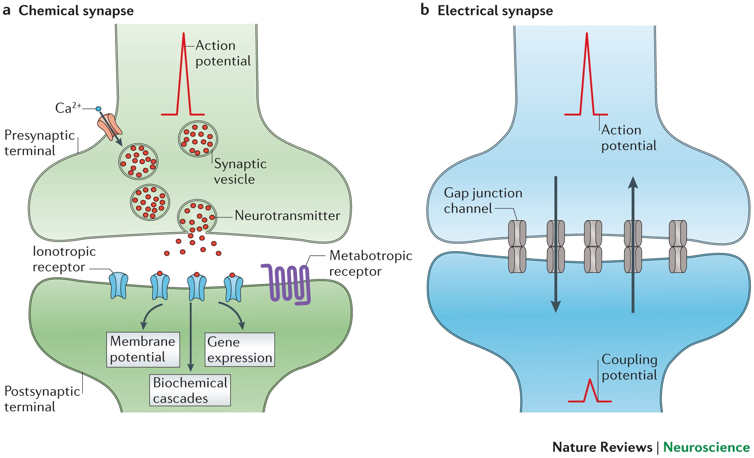

Slide 13
THANK YOU

