Slide 1
General and Molecular Genetics
Proofreading in Prokaryotes
By: Shozab Seemab Khan (PhD Scholar)

Slide 2
Proofreading in DNA Replication
Proofreading is a mechanism that ensures the fidelity of DNA replication by minimizing errors, such as incorrect base pairing.
During replication, DNA polymerases synthesize a new DNA strand complementary to the template strand.
However, mistakes can occur when an incorrect nucleotide is incorporated. Proofreading helps correct these mistakes, thereby maintaining genetic stability.

Slide 3
Proofreading in DNA Replication
Fidelity:
Ensures accurate copying of the genetic information.
Error Reduction:
Decreases the error rate from about 1 in 10,000 nucleotides to 1 in 10 million or even 1 in a billion nucleotides.
Genomic Stability:
Prevents mutations, which could lead to cellular dysfunction or diseases like cancer.

Slide 4
Key Steps in Proofreading
Synthesis: DNA polymerase adds nucleotides to the growing strand.
Recognition of Errors: When a mismatch occurs, the polymerase detects the incorrect base pair due to distortions in the DNA helix.
Exonuclease Activity: The enzyme's 3'→5' exonuclease activity removes the incorrect nucleotide.
Resynthesis: The polymerase resumes DNA synthesis, incorporating the correct nucleotide.

Slide 5
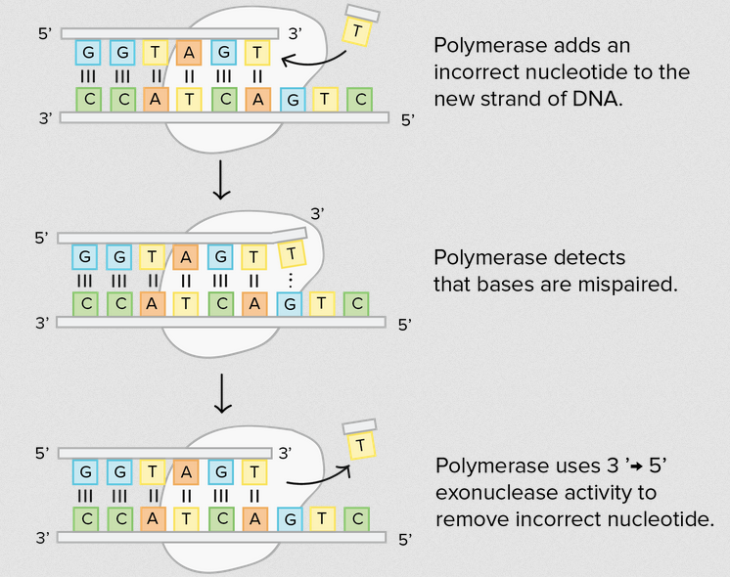

Slide 6
Enzymes Involved in Proofreading
1. DNA Polymerase III
Main Replicative Polymerase: Synthesizes the leading and lagging strands.
Proofreading Function: Possesses 3'→5' exonuclease activity to remove incorrectly paired nucleotides.
2. DNA Polymerase I
Role in Lagging Strand Processing: Removes RNA primers (using its 5'→3' exonuclease activity).
Replaces them with DNA nucleotides.
Proofreading: Also has 3'→5' exonuclease activity for error correction during gap filling.

Slide 7
Enzymes Involved in Proofreading
3: DNA Polymerase II
Role in DNA Repair and Maintenance: Functions in DNA repair processes by filling in small gaps and repairing mismatched or damaged nucleotides, especially during the SOS response to DNA damage.
Proofreading Function: Possesses 3'→5' exonuclease activity to remove incorrectly paired nucleotides, ensuring high fidelity during repair and gap-filling.
4. Helicase
Unwinding DNA: Separates the two DNA strands at the replication fork to provide single-stranded templates for synthesis.
Indirect Role in Fidelity: Ensures a proper template is available for accurate replication.

Slide 8
Enzymes Involved in Proofreading
5. Single-Strand Binding Proteins (SSBs)
Stabilization: Bind to single-stranded DNA to prevent reannealing and protect it from nuclease degradation.
Indirect Role in Fidelity: Maintains strand separation to facilitate accurate base pairing.
6. Primase
Synthesis of RNA Primers: Provides a starting point for DNA synthesis in lagging strand by adding RNA bases.
No Proofreading Role: Errors in primers are corrected later by DNA polymerase I.

Slide 9
Enzymes Involved in Proofreading
7. DNA Ligase
Joining Okazaki Fragments: Seals nicks in the sugar-phosphate backbone after RNA primers are replaced with DNA.
No Proofreading Function: Its role is structural rather than error-corrective.
8. Topoisomerase
Relieves Supercoiling: Prevents tangling and supercoiling ahead of the replication fork.
No Proofreading Role: Ensures smooth progression of the replication machinery.

Slide 10
Mechanism Ensuring Accuracy
Complementary Base Pairing: The polymerase initially relies on the base-pairing rules (A-T, G-C).
Proofreading by DNA Polymerase: Checks and corrects errors during synthesis.
Mismatch Repair System: Post-replication mechanism to fix any errors missed during proofreading.
In prokaryotes, the interplay of these enzymes ensures highly accurate DNA replication, vital for maintaining the integrity of the genome across generations.

Slide 12


