Slide 1
General and Molecular Genetics
mRNA Processing in Eukaryotes
By: Shozab Seemab Khan (PhD Scholar)

Slide 2
RNA Processing in Eukaryotes
After transcription, eukaryotic pre-mRNAs must undergo several processing steps before they can be translated.
Eukaryotic (and prokaryotic) tRNAs and rRNAs also undergo processing before they can function as components in the protein synthesis machinery.

Slide 3
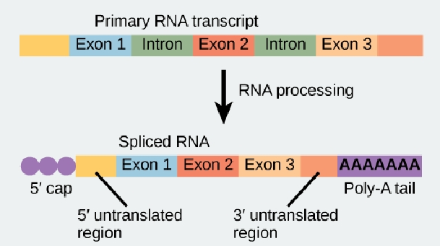
mRNA Processing in Eukaryotes
Eukaryotic mRNA contains introns that must be spliced out. A 5' cap and 3' poly-A tail are also added.
Notes:
Introns are non-coding regions of a gene that are transcribed into pre-mRNA but are removed during RNA splicing because they do not code for proteins and must be excluded to produce a functional mRNA transcript.
The 5' cap of eukaryotic mRNA is made up of a modified 7-methylguanosine (m7G) nucleotide attached to the 5' end of the mRNA via a unique 5'-to-5' triphosphate linkage.

Slide 4
mRNA Processing
The eukaryotic pre-mRNA undergoes extensive processing before it is ready to be translated.
The additional steps involved in eukaryotic mRNA maturation create a molecule with a much longer half-life than a prokaryotic mRNA.
Eukaryotic mRNAs last for several hours, whereas the typical E. coli mRNA lasts no more than five seconds.

Slide 5
mRNA Processing
Pre-mRNAs are first coated in RNA-stabilizing proteins; these protect the pre-mRNA from degradation while it is processed and exported out of the nucleus.
The most important steps of pre-mRNA processing are the addition of stabilizing proteins and signaling factors at the 5' and 3' ends of the molecule.
The removal of intervening sequences (introns) that do not specify the appropriate amino acids is also necessary.
In rare cases, the mRNA transcript can be “edited” after it is transcribed.

Slide 6
5' Capping
While the pre-mRNA is still being synthesized, a 7-methylguanosine cap is added to the 5' end of the growing transcript by a phosphate linkage.
This portion (functional group) protects the newly formed mRNA from degradation.
In addition, factors involved in protein synthesis recognize the cap to help initiate translation by ribosomes.

Slide 7
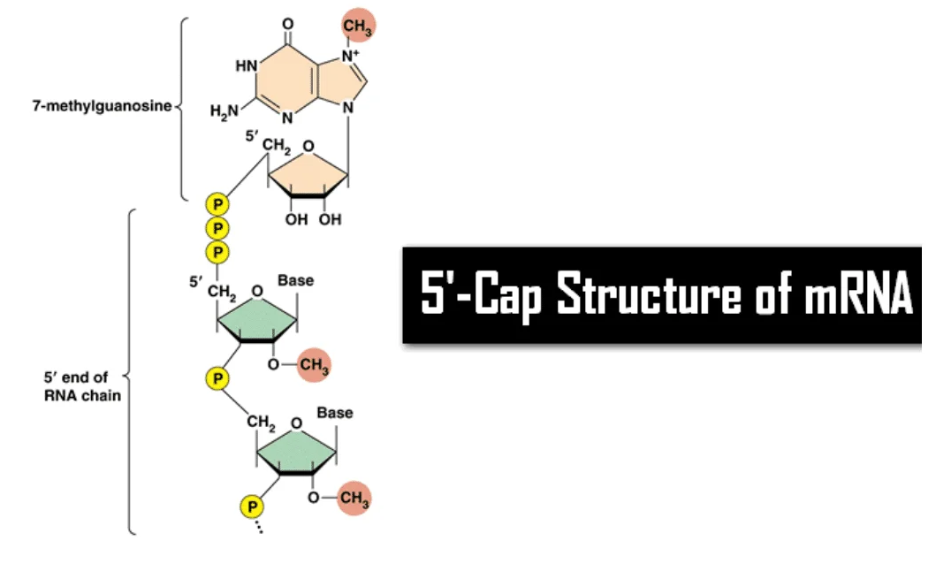

Slide 8
3' Poly-A Tail
Once elongation is complete, the pre-mRNA is cleaved by an endonuclease between an AAUAAA consensus sequence and a GU-rich sequence, leaving the AAUAAA sequence on the pre-mRNA.
An enzyme called poly-A polymerase then adds a string of upto 200 A nucleotides residues, called the poly-A tail.
This modification further protects the pre-mRNA from degradation and signals the export of the cellular factors that the transcript needs to the cytoplasm.

Slide 9
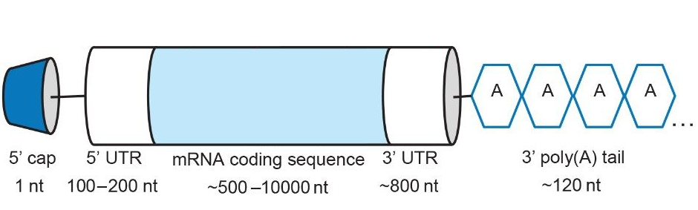
3' Poly-A Tail

Slide 10
Pre-mRNA Splicing
Eukaryotic genes are composed of exons, which correspond to protein-coding sequences (ex-on signifies that they are expressed).
mRNA also contain, intervening sequences called introns, which may be involved in gene regulation but are removed from the pre-mRNA during processing.
Intron sequences in mRNA do not encode functional proteins.

Slide 11
Pre-mRNA Splicing
The discovery of introns came as a surprise to researchers in the 1970s who expected that pre-mRNAs would specify protein sequences without further processing, as they had observed in prokaryotes.
The genes of higher eukaryotes very often contain one or more introns.
These regions may correspond to regulatory sequences; however, the biological significance of having many introns or having very long introns in a gene is unclear.

Slide 12
Pre-mRNA Splicing
It is possible that introns slow down gene expression because it takes longer to transcribe pre-mRNAs with lots of introns.
Alternatively, introns may be non-functional sequence remnants left over from the fusion of ancient genes throughout evolution.
This is supported by the fact that separate exons often encode separate protein subunits or domains.
The sequences of introns can be mutated without ultimately affecting the protein product.

Slide 13
Pre-mRNA Splicing
All of a pre-mRNA’s introns must be completely and precisely removed before protein synthesis.
If the process errors by even a single nucleotide, the reading frame of the rejoined exons would shift, and the resulting protein would be dysfunctional.
The process of removing introns and reconnecting exons is called splicing.
The splicing of pre-mRNAs is conducted by complexes of proteins and RNA molecules called spliceosomes.

Slide 14
Pre-mRNA Splicing
Introns are removed and degraded while the pre-mRNA is still in the nucleus. Splicing occurs by a sequence-specific mechanism that ensures introns will be removed and exons rejoined with the accuracy and precision of every single nucleotide.
Note that more than 70 individual introns can be present, and each has to undergo the process of splicing—in addition to 5' capping and the addition of a poly-A tail—just to generate a single, translatable mRNA molecule.

Slide 15
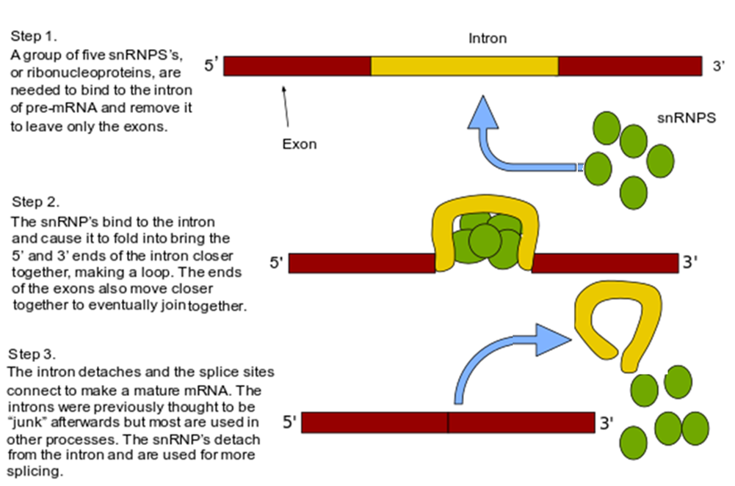

Slide 16
Processing of tRNAs and rRNAs
The tRNAs and rRNAs are structural molecules that have roles in protein synthesis; however, these RNAs are not themselves translated.
Pre-rRNAs are transcribed, processed, and assembled into ribosomes in the nucleolus.
Pre-tRNAs are transcribed and processed in the nucleus and then released into the cytoplasm where they are linked to free amino acids for protein synthesis.

Slide 17
Processing of tRNAs and rRNAs
Most of the tRNAs and rRNAs in eukaryotes and prokaryotes are first transcribed as a long precursor molecule that spans multiple rRNAs or tRNAs.
Enzymes then cleave the precursors into subunits corresponding to each structural RNA. Some of the bases of pre-rRNAs are methylated; that is, a –CH3 portion (methyl functional group) is added for stability.
Pre-tRNA molecules also undergo methylation. As with pre-mRNAs, subunit excision occurs in eukaryotic pre-RNAs destined to become tRNAs or rRNAs.

Slide 18
Processing of tRNAs and rRNAs
Mature rRNAs make up approximately 50 percent of each ribosome. Some of a ribosome’s RNA molecules are purely structural, whereas others have catalytic or binding activities.
Mature tRNAs take on a three-dimensional structure through intramolecular hydrogen bonding to position the amino acid binding site at one end and the anticodon at the other end.
The anticodon is a three-nucleotide sequence in a tRNA that interacts with an mRNA codon through complementary base pairing.

Slide 19
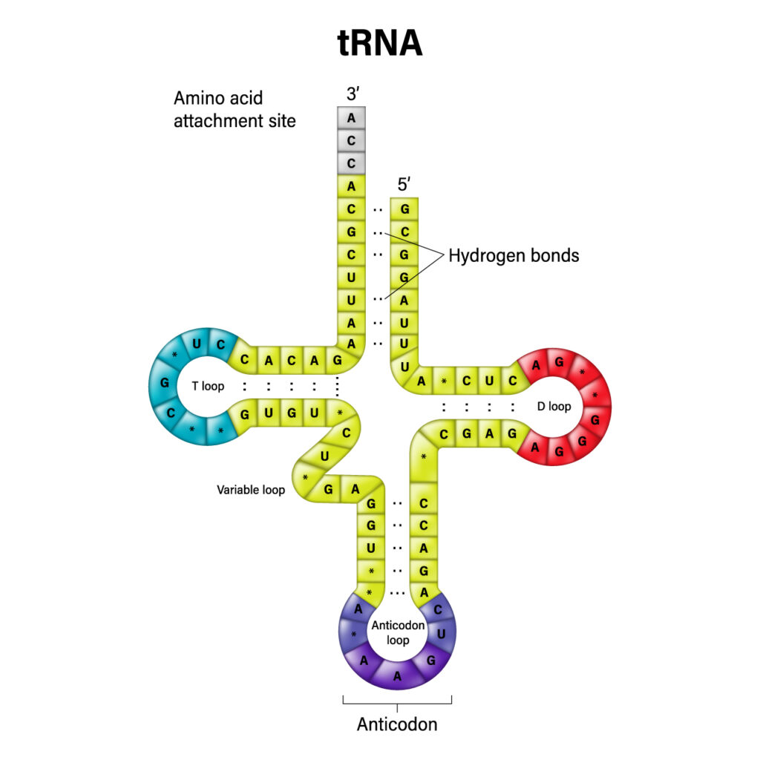
Notes:
D-loop
A loop of 4–6 bases that ends with dihydrouridine, a modified nucleotide. The D-loop is closed by a Watson-Crick base pair.
T-loop
Also known as the TψC-loop, this loop contains thymine and pseudouridine (ψ).

Slide 20
Summary
Eukaryotic pre-mRNAs are modified with a 5' methyl-guanosine cap and a poly-A tail.
These structures protect the mature mRNA from degradation and help export it from the nucleus.
Pre-mRNAs also undergo splicing, in which introns are removed and exons are reconnected with every single-nucleotide accuracy.

Slide 21
Summary
Only finished mRNAs that have undergone 5' capping, 3' polyadenylation, and intron splicing are exported from the nucleus to the cytoplasm.
Pre-rRNAs and pre-tRNAs may be processed by intramolecular cleavage, splicing, methylation, and chemical conversion of nucleotides.
Rarely, RNA editing is also performed to insert missing bases after an mRNA has been synthesized.

Slide 22
Terms
7-Methyl-Guanosine Cap: Modification added to the 5' end of pre-mRNAs to protect mRNA from degradation and assist translation.
Anticodon: Three-nucleotide sequence in a tRNA molecule that corresponds to an mRNA codon.
Exon: Sequence present in protein-coding mRNA after completion of pre-mRNA splicing.
Intron: Non–protein-coding intervening sequences that are spliced from mRNA during processing.

Slide 23
Terms
Poly-A Tail:
Modification added to the 3' end of pre-mRNAs to protect mRNA from degradation and assist mRNA export from the nucleus.
RNA Editing:
Direct alteration of one or more nucleotides in an mRNA that has already been synthesized.
Splicing:
Process of removing introns and reconnecting exons in a pre-mRNA.

Slide 24


