Slide 1

CELL CYCLE
&
ITS REGULATION
By: Shozab Seemab Khan
ABAIDULLAH COLLEGE PAKPATTAN

Slide 2
CELL CYCLE
Cell cycle was described by Howard and Pele in 1953.
Cell cycle is defined as the stages through which a cell passes from one cell division to the next. During this phase the cell grows and prepares for the division.
Whole of the cell cycle is alternated with –
Doubling of genome (DNA) in synthesis phase (S phase)
Halving of that genome during mitosis (M phase)

Slide 3
CELL CYCLE
Cell cycle – Completes in 2 phases
(I) Interphase – Preparatory phase, divided into 3 sub phases
G1 (GAP 1) phase
S (Synthesis) phase
G2 (GAP 2) phase
Leading to Doubling of genome (DNA)
(II) M phase – Phase of division, divided into 2 sub phases
Karyokinesis (Nuclear division) – divided into 4 sub phases
Prophase
Metaphase
Anaphase
Telophase
Cytokinesis (Division of cytoplasm)
Leading to Halving of that genome, passing into daughter cells

Slide 4
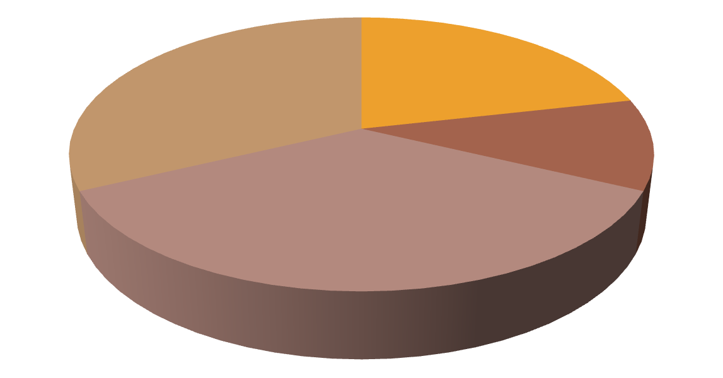


CELL CYCLE
G2
S
M
G1
Daughter cells
G0
Different phases of cell cycle (cell growth & cell division)

Slide 5
CELL CYCLE
EVENTS OCCURRING IN G1 PHASE:
SYNTHESIS OF ENZYMES REQUIRED FOR DNA
REPLICATION
SYNTHESIS OF RNA NEEDED FOR TRANSCRIPTION AND
TRANSLATION
SYNTHESIS OF ATP
SYNTHESIS OF RAW MATERIALS (PENTOSE SUGAR, PHOSPHORIC ACID AND NITROGENASES) FOR DNA DUPLICATION IN S PHASE
SO MANY THINGS ARE SYNTHESIZED IN THIS PHASE,
THEREFORE, THE SIZE OF THE CELL INCREASES
NOW THE CELL IS READY TO ENTER THE NEXT S PHASE.

Slide 6
CELL CYCLE
EVENTS OCCURRING IN S PHASE:
DNA REPLICATION
CENTRIOLE DIVIDES (ONLY IN ANIMALS)
SYNTHESIS OF HISTOINE PROTEINS
NOW THE CELL IS READY TO ENTER THE NEXT G2 PHASE.

Slide 7
CELL CYCLE
EVENTS OCCURRING IN G2 PHASE:
SYNTHESIS OF TUBULIN PROTEIN REQUIRED FOR SPINDLE
FORMATION
SYNTHESIS OF PROTEIN REQUIRED FOR PLASME MEMBRANE
FORMATION
CELL ORGANELLES ARE DOUBLED
LOTS OF ATP MOLECULES REQUIRED FOR MOVEMENT OF CHROMOSOMES FROM EQUATOR TO POLE (30 ATP/ CHROMOSOME). SO ATP SYNTHESIS INCREASES.
RNA SYNTHESIS TAKES PLACE
NOW THE CELL IS READY TO ENTER THE NEXT M PHASE.

Slide 8
CELL CYCLE
EVENTS OCCURRING IN M PHASE:
KARYOKINESIS INCLUDES
PROPHASE: CHROMATID COILING, DISINTEGRATION OF NUCLEAR MEMBRANE AND NUCLEOLUS, SPINDLE FORMATION
METAPHASE: CHROMOSOMAL ORIENTATION AT THE
EQUATORIAL PLANE
ANAPHASE: MOVEMENTS OF CHROMATIDS TOWARDS
THE OPPOSITE POLES
TELOPHASE: RECONSTRUCTION OF DAUGHTER NUCLEI
CYTOKINESIS INCLUDES
FORMATION OF CELL PLATE LEADING TO EQUAL DIVISION OF CYTOPLASM, NUCLEI, CELL ORGANELLES AND CELL MEMBRANE INTO TWO DAUGHTER CELLS

Slide 9
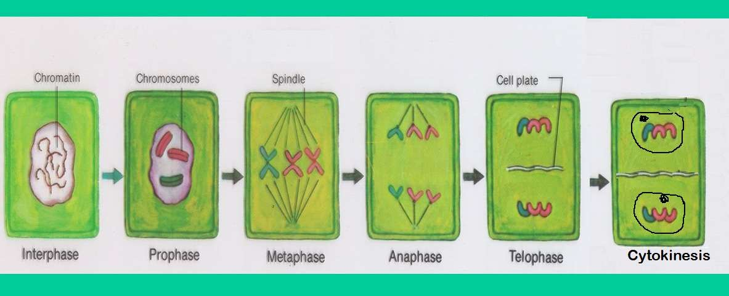
CELL CYCLE
Stages of cell cycle

Slide 10
CELL CYCLE
AFTER CELL DIVISION, EACH OF THE DAUGHTER CELL
BEGINS THE INTERPHASE OF A NEW CYCLE.
SOME CELLS (eg. CELLS OF HEART, KIDNEY, LIVER, NEURONS etc. ) AFTER REMAINING IN G1 PHASE FOR SOMETIME COME OUT OF THE CELL CYCLE AND ENTER Go PHASE KNOWN AS QUIESCENT PHASE.
IN QUIESCENT PHASE THE CELL DIVISION STOPS BUT
OTHER ACTIVITIES OF THE CELL CONTINUE.
SOMETIMES THE CELL REENTERS THE CELL CYCLE FROM
QUIESCENT PHASE WHEN REQUIRED.
Eg. DURING FORMATION OF PERIDERM

Slide 11


CELL CYCLE
4C
2C
G1 S G2 M G1
Cell cycle of a cell showing the changes in DNA
content during various phases

Slide 12
REGULATION OF CELL CYCLE
Cell cycle does not occur in unchecked manner. The preparations of the cell are checked by regulatory molecules. It includes the detection and repair of genetic damage as well as prevention of uncontrolled cell division.
There are two key classes of regulatory molecules that determine a cell’s proper progress through the cell cycle. These are -
Cyclins
Cyclin dependent kinases (Cdk)
The Nobel Prize in Physiology or Medicine 2001 was
awarded jointly to Leland H. Hartwell, Tim Hunt and Sir Paul
M. Nurse for their discoveries of key regulators of the cell
cycle.

Slide 13
REGULATORY MOLECULES
Cyclins-
G1 Cyclins (D cyclins)
S-phase cyclins (cyclins E and A)
M-phase cyclins (B cyclins)
Cyclin dependent kinases
G1 Cdk (Cdk 4)
S-phase Cdk (Cdk 2)
M-phase Cdk (Cdk 1)
Their levels in the cell remain stable.
Remain inactive.
Bind to the appropriate cyclin
in order to be activated.
Their function is to provide phosphate group to a number of proteins that control processes in the cell cycle.
Their levels in the cell rise and fall with the stages of the cycle.

Slide 14
REGULATORY MOLECULES
Table 1: Cyclin – Cyclin dependent kinases (Cdk) complexes formed during cell cycle reguation and their functions
Phase of cell cycle | Cyclin | Cdk | Cyclin-Cdk complx | Function
G1 | Cyclin D | Cdk 4 | G1 Cyclin-G1 Cdk | Inhibits Rb (Retinoblastoma) protein and signals the cell to prepare the chromosome for replication
S | Cyclin E and Cyclin A | Cdk 2 | S phase cyclin – S phase Cdk | Activates DNA replication
G2 | Cyclin B | Cdk 1 | Mitotic cyclins – M phase Cdk | Activates mitosis

Slide 15
CELL CYCLE CHECKPOINTS
CELL CYCLE CHECKPOINTS ARE USED BY THE CELL TO MONITOR AND REGULATE THE PROGRESS OF THE CELL CYCLE. THE CELL CANNOT PROCEED TO THE NEXT PHASE UNTIL CHECKPOINT REQUIREMENTS HAVE BEEN MET.
THREE MAIN CHECKPOINTS ARE:
G1/S CHECKPOINT (before cell enters S phase)
G2/M CHECKPOINT (after S phase)
APC/C CHECKPOINT (during mitosis)
(Anaphase Promoting Complex / Cyclosome)

Slide 16
CELL CYCLE CHECKPOINTS
(I) G1/S CHECKPOINT (before cell enters S phase):
Checks for cell size
Checks for nutrients
Checks for DNA damage
Checks for all the preparations (all proteins,
ATP etc. requires in S phase)
Checks whether S phase Cyclins and Cdk complex is activated to initiate DNA replication
Then the cell passes to next S phase.

Slide 17
CELL CYCLE CHECKPOINTS
(I) G2/M CHECKPOINT (after S phase):
Checks for proper DNA replication
Checks for all the preparations (all proteins,
ATP etc. required in M phase)
Checks for Tubulin synthesis
Checks whether M phase Cyclins and Cdk
complex is activated to initiate mitosis
Then the cell passes to next M phase.

Slide 18
APC / C CHECKPOINT
Anaphase Promoting Complex / Cyclosome Checkpoint
It refers to a critical control point in the cell cycle that regulates the timing of anaphase
It ensures that all chromosomes are properly aligned and attached to the mitotic spindle before separation occurs.
It is part of the spindle assembly checkpoint (SAC), which prevents premature progression into anaphase and ensures genomic stability.

Slide 19
CELL CYCLE CHECKPOINTS
ALL THE CHECKPOINTS REQUIRE THE SERVICES OF A COMPLEX OF PROTEINS. THE LEVELS OF THESE PROTEINS ARE INCREASED IN DAMAGED CELLS. THEY ALLOW TIME TO REPAIR DNA BY BLOCKING THE CELL CYCLE.
P53 IS ONE SUCH PROTEIN WHICH SENSES DNA DAMAGE AND CAN HALT PROGRESSION OF THE CELL CYCLE IN G1 PHASE BY BLOCKING THE ACTIVITY OF Cdk 2 UNTIL DAMAGE CAN BE REPAIRED. IF THE DAMAGE IS SO SEVERE THAT IT CAN NOT BE REPAIRED, THEN THE CELL DESTRUCTS ITSELF BY APOPTOSIS.
IN CASE OF DAMAGE TO DNA AFTER S PHASE, THE ACTION OF CDK 1 IS INHIBITED, THUS STOPPING PROGRESSION OF THE CELL FROM G2 TO MITOSIS.

Slide 20
THANK YOU

