Slide 1
General and Molecular Genetics
Regulation of Gene Expression
Inducive and Repressive Operons
(e.g. Lac operon).
By: Shozab Seemab Khan (PhD Scholar)

Slide 2
Regulation of Gene Expression
Regulation of gene expression refers to the mechanisms that control how genes are turned on or off, and how much of a gene’s product (usually a protein) is made.
Genes contain the instructions to make proteins, which are crucial for almost every function in a cell. But not all proteins are needed all the time.
So cells have ways to regulate the production of these proteins based on need, environment, or other signals.

Slide 3
Inducive and Repressive Operons
Regulation of gene expression via inducible and repressible operons occurs primarily in prokaryotes, particularly bacteria, using the operon model.
Operons are clusters of genes controlled by a single promoter and regulatory elements.
These mechanisms (inducive and repressive operons) help bacteria to efficiently regulate gene expression based on environmental conditions.

Slide 4
1. Inducive Operon (e.g., Lac Operon)
Normally off but can be turned on when needed.
Requires an inducer molecule to activate transcription.
Example: Lac Operon (E. coli)
Controls the breakdown of lactose.
In the absence of lactose, a repressor protein binds to the operator, preventing transcription.
When lactose is present, it binds to the repressor, inactivating it, allowing RNA polymerase to transcribe the genes needed to metabolize lactose.

Slide 5
2. Represive Operon (e.g., Trp Operon)
Normally on but can be turned off when the product is abundant.
Requires a co-repressor molecule to stop transcription.
Example: Trp Operon (E. coli)
Regulates tryptophan biosynthesis.
When tryptophan levels are low, the operon is active, and enzymes for tryptophan synthesis are produced.
When tryptophan is abundant, it acts as a co-repressor, binding to the repressor protein, activating it, and blocking transcription to prevent excess tryptophan production.

Slide 6
The Lac Operon
A Classic Example of Gene Regulation
One of the most famous examples of gene regulation is the lac operon in E. coli bacteria.
This operon is a group of genes that are involved in the metabolism of lactose (a sugar found in milk).

Slide 7
Components of lac operon
1. Genes:
lacZ: Produces the enzyme β-galactosidase.
It breaks down lactose into simpler sugars (glucose and galactose).
lacY: Produces permease.
A protein that helps lactose enter the bacterial cell.
lacA: Produces transacetylase.
It help remove waste products during lactose metabolism.
lacI: Produces repressor protein.
It binds to the operator region to switch it off.

Slide 8
Components of lac operon
2. Regulatory Elements:
Promoter:
A region of DNA where the RNA polymerase (the enzyme that makes RNA from DNA) binds to start transcription.
Operator:
A segment of DNA that acts as an on/off switch. It is where the repressor protein binds.
Repressor:
A protein which binds on operator to switch it off.

Slide 9
How the lac operon is regulated
1. When lactose is absent:
The repressor protein (made by the lacI gene) binds to the operator region.
This binding blocks RNA polymerase from transcribing the structural genes (lacZ, lacY, and lacA).
Result:
No enzymes for lactose metabolism are made because the cell doesn't need them (there's no lactose to break down).

Slide 10
How the lac operon is regulated
2. When lactose is present:
Lactose acts as an inducer. It binds to the repressor protein.
When the lactose binds with repressor, it changes shape and can't bind to the operator anymore.
This allows RNA polymerase to bind to the promoter and start transcribing the lacZ, lacY, and lacA genes.
Result:
The cell produces the enzymes needed to break down lactose, which it can use as a source of energy.

Slide 11
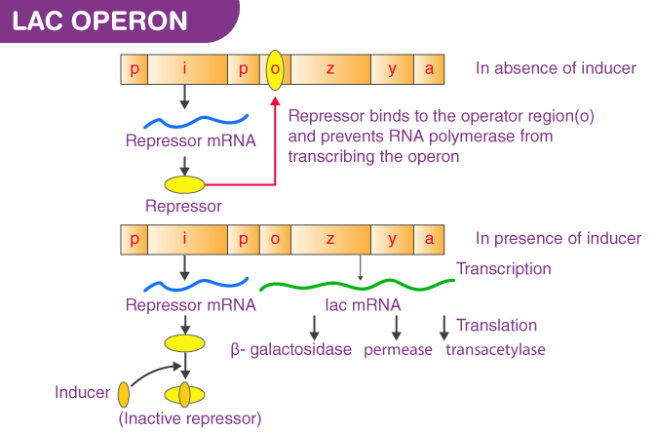

Slide 12
Positive Regulation: The Role of Glucose
Bacteria prefer to use glucose over lactose because it’s easier to metabolize. So, if glucose is present, even if lactose is available, the lac operon will still remain off or operate at low levels. This is controlled by a mechanism known as catabolite repression:
When glucose levels are low, a molecule called cyclic AMP (cAMP) increases in the cell.
cAMP binds to a protein called CRP (cAMP receptor protein) or CAP (catabolite activator protein). Together, this cAMP-CRP complex helps RNA polymerase bind more effectively to the lac operon promoter, enhancing transcription.
If glucose is high, the cAMP levels drop, and the lac operon remains less active, even if lactose is present.

Slide 13
Summary
The lac operon is a flexible system that allows E. coli to regulate the production of enzymes for lactose metabolism based on environmental conditions:
If lactose is absent > Genes stay off.
If lactose is present and glucose is low > Genes are turned on.
If glucose is high > System stays off or operates very slow, even if lactose is present.
This ability to turn genes on and off in response to environmental changes is a key feature of gene regulation across many organisms, though the mechanisms can be more complex in higher organisms.

Slide 14


