Slide 1
Nucleic Acid and its Structure - DNA, RNA, DNA as Genetic Material
By: Shozab Seemab Khan
(PhD Scholar)
ABAIDULLAH COLLEGE PAKPATTAN

Slide 2
Nucleic Acids
Nucleic acid is an important class of macromolecules found in all cells and viruses. The functions of nucleic acids have to do with the storage and expression of genetic information. Deoxyribonucleic acid (DNA) encodes the information the cell needs to make proteins. A related type of nucleic acid, called ribonucleic acid (RNA), comes in different molecular forms that participate in protein synthesis.
Nucleic acids are polynucleotides
Their building blocks are nucleotides

Slide 3
Nucleic Acids
The nucleic acids are vital biopolymers found in all living organisms, where they function to encode, transfer, and express genes. The nucleic acids are of two types, namely deoxyribonucleic acid (DNA) and ribonucleic acid (RNA)
HISTORY:
Friedric Miescher (1868) discovered an acidic substance from pus cells and named it as Nuclein
Altman (1889) coined the term Nucleic Acids

Slide 4
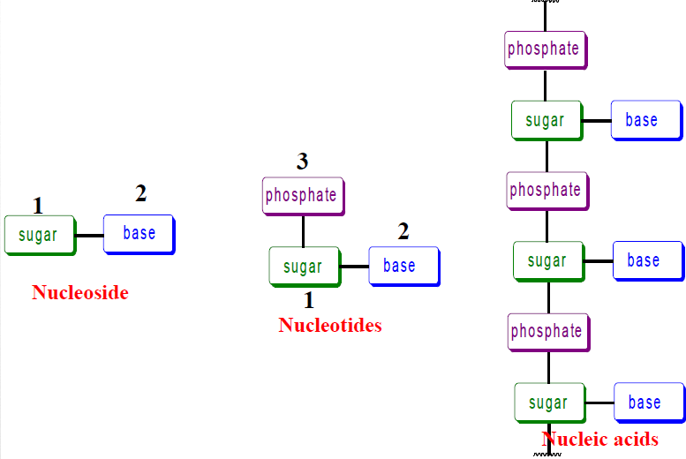

Slide 5
NITROGEN BASES
Purines
Adenine, Guanine
Dicyclic molecules
4 N atoms at 1,3,7,9 positions
Glycosidic bond formed between 1 C of pentose sugar and N (9) of purine
Pyrimidines
Cytosine,Thymine, Uracil
Monocyclic molecules
2 N atoms at 1,3 positions
Glycosidic bond formed between 1 C of pentose sugar and N (1) of pyrimidine

Slide 6
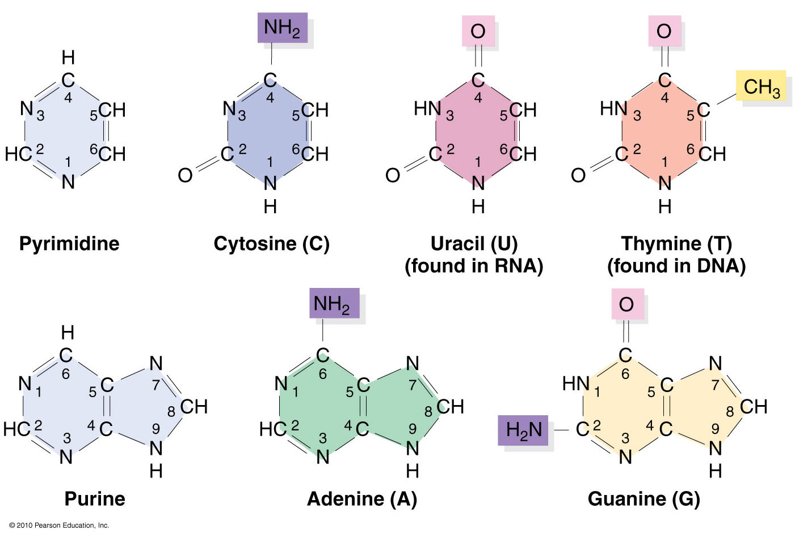

Slide 7
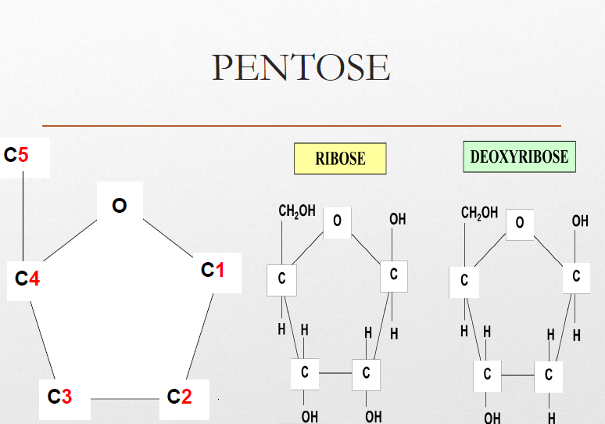
Pentose sugar:
Form glycosidic bond
RNA – Ribose sugar
DNA – Deoxyribose sugar

Slide 8
Phosphoric acid
Attached to 5 C of pentose sugar by phosphodiester bond

Slide 9
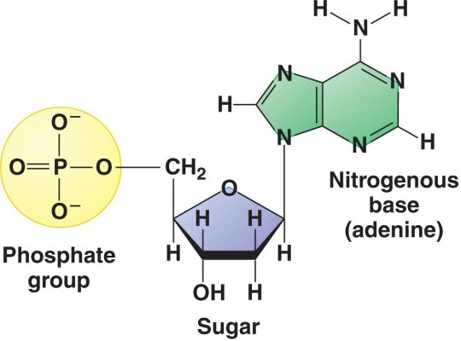
Nucleotide:

Slide 10
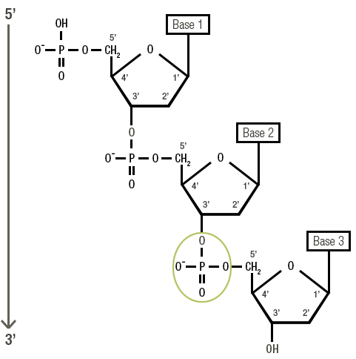

Slide 11
Minor bases
Several minor & unusual bases are often found in DNA & RNA
These include 5-methylcytosine, N4-acetylcytosine, N6 methyl
adenine, N6 dimethyl adenine, dihydrouracil & N7 methylguanine
Importance:
The unusual bases in nucleic acids help in the recognition of
specific enzymes.

Slide 12
DNA
Location: In eukaryotes it is present in nucleus (chromosomes) and lesser amounts in mitochondria and chloroplasts.
In prokaryotes it is found in cytoplasm.
Structure: Double stranded structure, however in some viruses it is single stranded.
Shape: In eukaryotes, DNA is of linear shape. In prokaryotes and mitochondria DNA is circular.
Replication: Semi-conservative manner.
Types: A , B, and Z forms of DNA.
Functions: Stores and transforms genetic information and involved in mRNA synthesis.

Slide 13
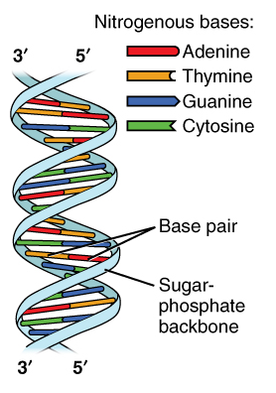
STRUCTURE OF DNA: Watson and Crick proposed double helix structure in 1953 (term DNA - Zacharis)
Features of DNA double helix structure:
Double helix structure
Each strand is made up of a chain of nucleotides
2 strands run antiparallel to each other
Purine always pairs with pyrimidine
The diameter of the helix is 20 Å. Pitch of the helix is 34 Å (Angstrom) and 10 bp in each turn. Adjacent bases are separated by 3.4 Å.
The two chains are held together by hydrogen bonds between the nitrogen bases. (A=T, C=G)
Helix in clockwise (righthanded)

Slide 14
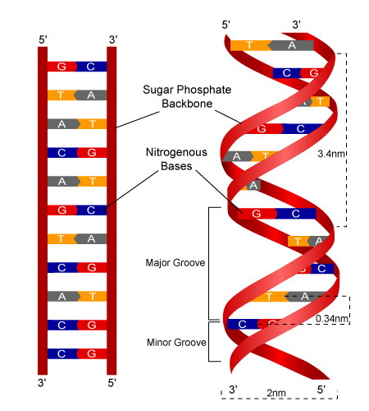

Slide 15
CHARGAFF’S RULE
Purine = Pyrimidine.
A = T & G = C
A + G / C + T = 1.
CG Rule: The overall G+C content is species specific, it tends to be higher in exons than the introns

Slide 16
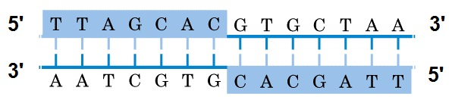
PALINDROME SEQUENCE
HYPERCHROMATIC EFFECT
It is the striking increase in absorbance of DNA upon denaturation

Slide 17
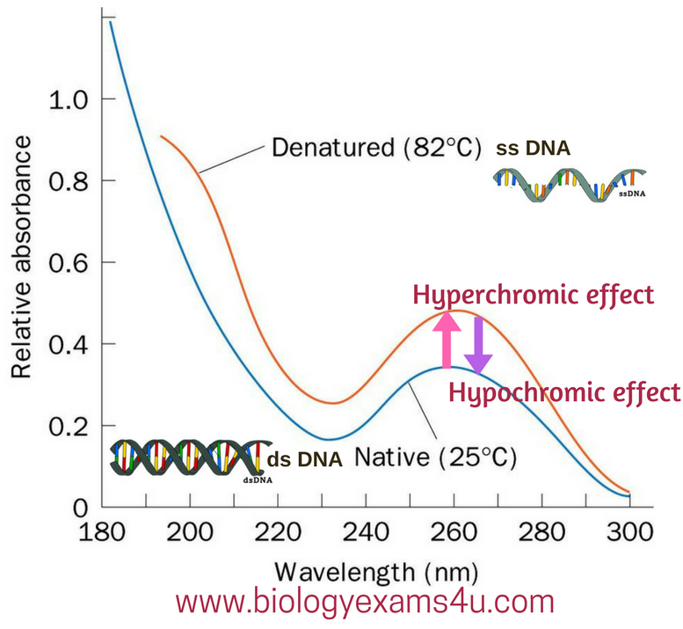

Slide 18
Which Came First?
RNA OR DNA
Most scientists believe RNA evolved before DNA. RNA has a simpler structure and is needed in order for DNA to function. Also, RNA is found in prokaryotes.
RNA on its own can act as a catalyst for certain chemical reactions.
Why DNA evolved if RNA existed?
Having a double-stranded molecule helps protect the genetic code from damage. If one strand is broken, the other strand can serve as a template for repair.

Slide 19
RNA
A nucleic acid that carries the genetic message from DNA to ribosomes and is involved in the process of protein synthesis is referred to as RNA. It contains:
Ribose sugar
Nitrogen base (A, G, U, C)
Phosphoric acid

Slide 20
Heterogeneous RNA (hnRNA):
Precursor RNA synthesized from DNA through transcription. Contains both exons and introns.
Messenger RNA (mRNA) :
It constitutes about 5% of total RNA in the cell.
Role: carries the information for the protein synthesis.
mRNA is formed after processing of hnRNA. Processed through the process of capping (7-methyl guanosine is added to the 5’ terminal end), tailing, splicing and base modifications.

Slide 21
Transfer RNA (tRNA) (soluble RNA or adapter molecules)
Smallest of all the 3 major RNA (mRNA, rRNA, tRNA)
Role : transfers amino acids from cytoplasm to protein synthesis machinery.
The first nucleic acid to be completely sequenced was tRNA (tRNA alanine), by HOLLEY and Co-workers.
Ribosomal RNA( rRNA) :
rRNA is synthesized in nucleolus.
Role: Plays an important role in binding of mRNA to ribosome and its translation.

Slide 22
Functions of RNA:
Storage function: Many viruses have RNA as genetic material, it may be ssRNA or dsRNA.
Structural RNA: rRNA is the major component of ribosome.
Transfer function: mRNA encodes for protein synthesis involved in transfer of genetic information.
Catalytic function: RNA in ribosomes has peptidyl transferase activity which is responsible for formation of peptide bond between the amino acids. Ribozymes have catalytic activity.
Regulatory function: siRNA (short interfering RNA), miRNA (micro RNA) are involved in plant defense mechanism.

Slide 23
Differences between DNA and RNA:
Particulars | DNA | RNA
Location | Nucleus (chromosome), mitochondria, chloroplast, cytoplasm | Nucleolus, cytoplasm and ribosomes
Replication | Self replication | Self replication is rare
Types | A,B and Z forms | mRNA, tRNA, and rRNA
Strands | Usually two, rarely one | Usually one , rarely two
Bases | A,G,C and T | A, G, C and U
Base pairing | AT and GC | AU and GC
Sugar | Deoxyribose | Ribose
Size | Upto 4.3 million nucleotides | Upto 12000 nucleotides
Function | Genetic role | Protein synthesis. Genetic in some viruses

Slide 24
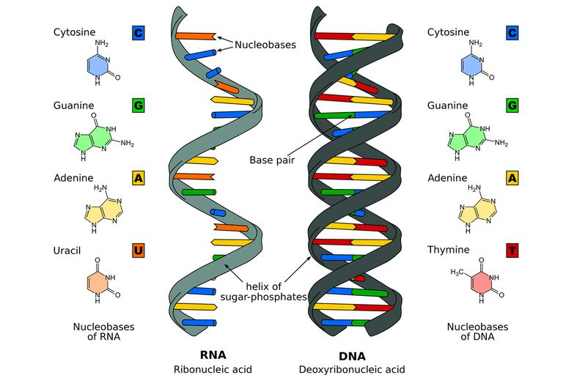

Slide 25
CHARACTERISTICS OF GENETIC MATERIAL
Replication
Storage information for the expression of the trait
Control expression of traits
Change in controlled way (Undergo Mutation)
Must be stable

Slide 26
Is the Genetic Material Protein or DNA?
Until 1940 Proteins were considered as genetic material as proteins are polymer of 20 protein amino acids and present in larger quantity, encode more and variety of information.
DNA is polymer of only 4 different deoxyribonucleotides (ATP, CTP, GTP & TTP) and is present in smaller quantity

Slide 27
Evidences which prove DNA as Genetic Material
Frederick Griffith’s (1928) experiment on Bacterial Transformation
Oswald Avery, Colin Macleod and Maclyn McCarty’s (1944) experiment on Transformation
Alfred D. Hershey and Martha Chase (1952) experiment on T- Even (2,4 ) Bacteriophage

Slide 28
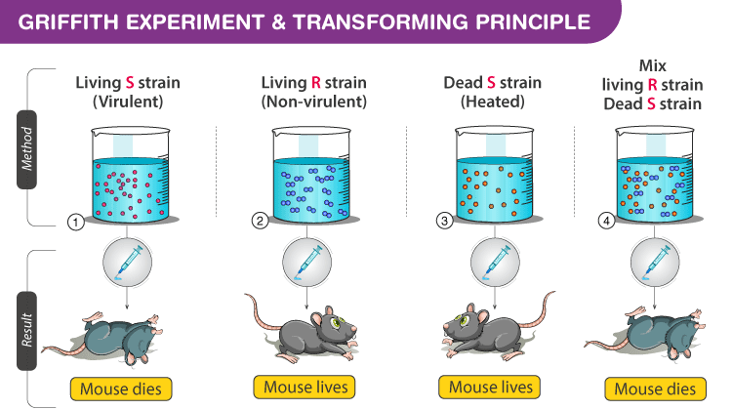
GRIFFITH’S EXPERIMENT ON BACTERIAL TRANSFORMATION (1928)

Slide 29
It was postulated that some of the cells of R type had changed into S type due to the influence of the dead S cells present in the mixture
This phenomenon was called transformation.
The components of the S cells which induced the conversion of R cells into S cells was named the transforming principle.

Slide 30
Avery, Macleod and Mc Carty (1944) experiment on Transformation
Carried out the experiments of Griffith in vitro
They concluded that DNA was the genetic material and not the proteins. Because the transformation occurred when the DNA was present in the extract and there was no transformation when DNA was digested with DNAase enzyme

Slide 31
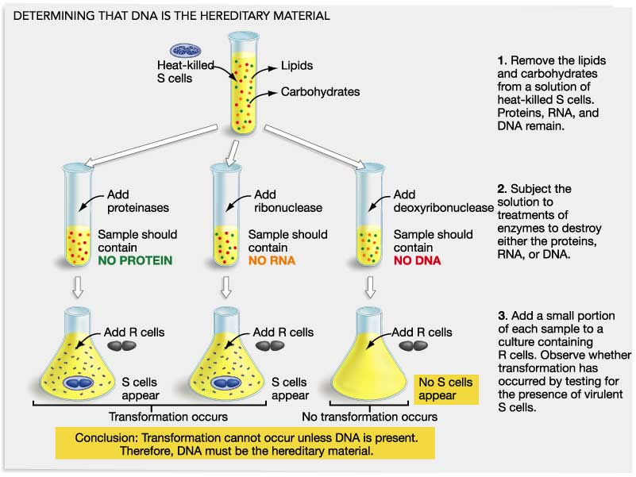

Slide 32
THANK YOU

