Slide 1
STRUCTURE OF DNA A, B and Z Form
By: Shozab Seemab Khan
(PhD Scholar)
ABAIDULLAH COLLEGE PAKPATTAN

Slide 2
Different Types of DNA Conformations
DNA, the genetic information carrier molecule of the cell, is a long polymer of nucleotides and can adopt different types of structural conformations. The various types of conformations that the DNA can adopt depend on different factors such as:
1. Hydration level
2. Salt concentration
3. DNA sequence
4. Quantity and direction of super-coiling
5. Presence of chemically modified bases
6. Different types of metal ions and its concentrations
7. Presence of polyamines in solution.

Slide 3
Different Types of DNA Conformations
The most common types of structural conformations of DNA are named as:
(1). A-DNA
(2). B-DNA
(3). Z-DNA
Among these three types, the most abundant type of DNA is B-DNA, commonly known as Watson-Crick Model of DNA double helix.

Slide 4
B-DNA
The B-DNA is the most common and predominate type of structural conformation of DNA in the cells. The DNA prefers to occur in B form under the natural physiological conditions (pH and salt concentration) in the cell.
The B-DNA is better described as the Watson – Crick Model of DNA described for the first time by James Watson and Francis Crick. Important structural features of B-DNA are given below:
Majority of the DNA in a cell is in B-DNA conformation.
B-DNA is a right handed helix.

Slide 5
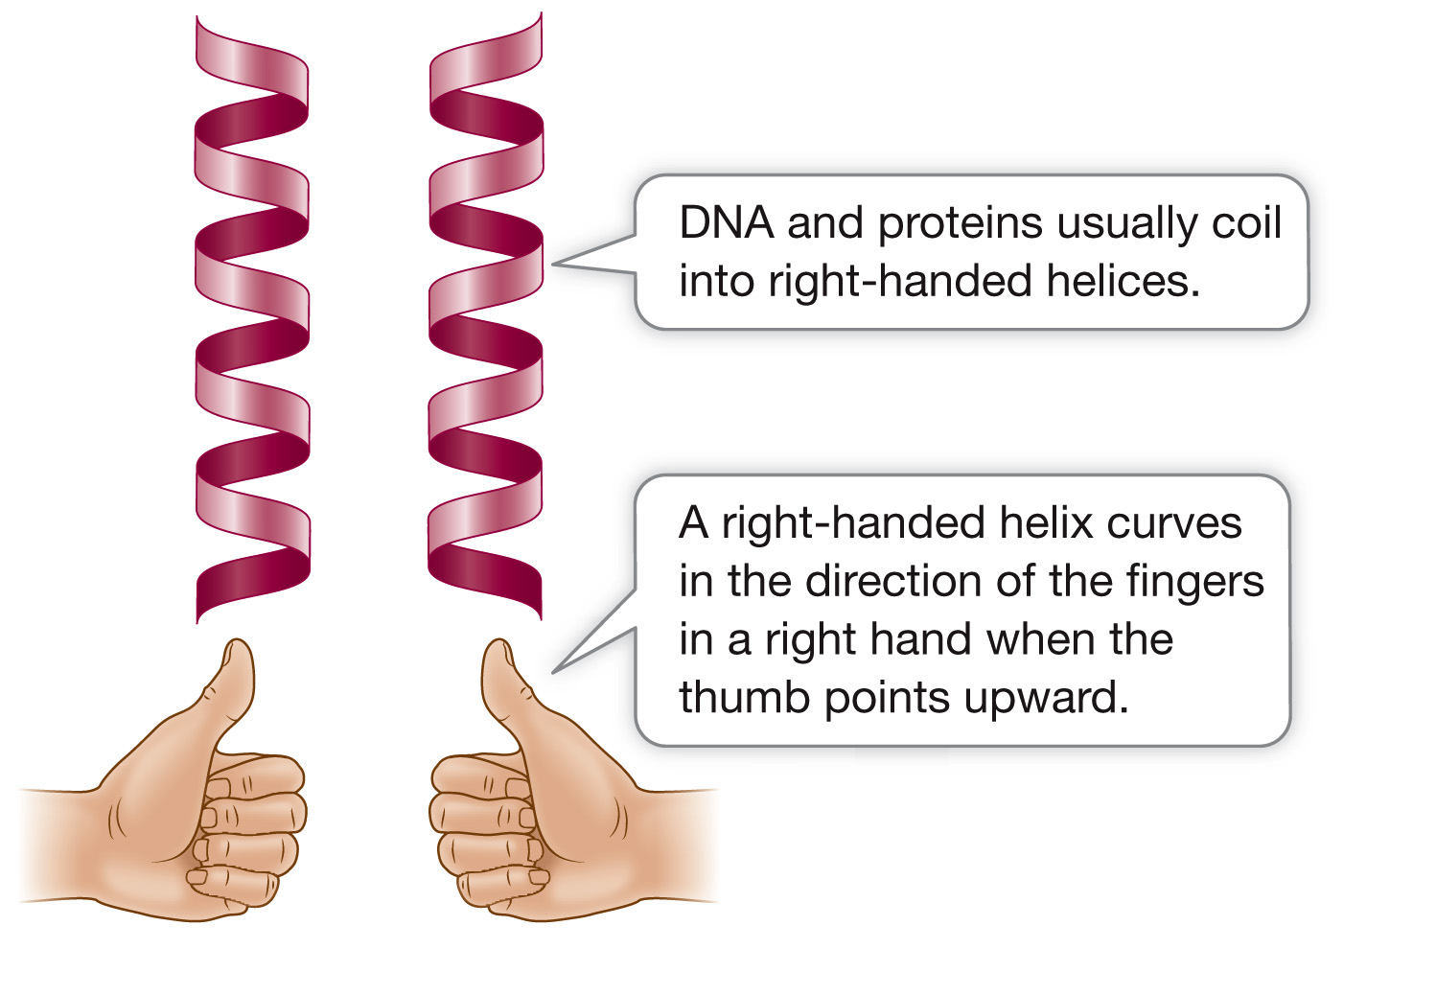

Slide 6
B-DNA
In B-DNA, the bases occupy at the core whereas the sugar phosphate backbone occurs at the peripheral portion of the helix.
In B-DNA only the edges of the base pairs are exposed to the solvent.
Each base pair in B-DNA has the same width.
The width of A – T and G – C in B-DNA is 10.85 Å.
The helical diameter of B-DNA is 20 Å.
Each turn on helix in B-DNA possess a helical height of 34 Å.
Each turn in the B-DNA consists of 10 base pairs.

Slide 7
B-DNA
The distance between adjacent base pairs in B-DNA is 3.4 Å.
Each base pair will have a helical twist of 36⁰ (360/10).
The plain of inter-strand hydrogen bonds are perpendicular to the helical axis.
B-DNA has a solid central core.
The major grove of B-DNA is wide and deep.
The minor grove of B-DNA is narrow and deep.
The sugar pucker in B-DNA is C2’ endo form.
The glycosidic bond conformation in B-DNA is in anti- form.

Slide 8
A-DNA
A-DNA is a rare type of structural conformation that a DNA can adopt under dehydrating conditions. A-DNA is a double stranded helical structure almost similar to B-DNA but with a shorter and more compact structural organization.
A-DNA was discovered by Rosalind Franklin and the credit for the naming of A-DNA and B-DNA was also accounted to her.
Important structural features of A-DNA are given below:
A-DNA is formed from B-DNA under dehydrating condition.
A-DNA is much wider and flatter than B-DNA.

Slide 9
A-DNA
Similar to B-DNA, the A-DNA is also a right handed helix.
The helix diameter of A-DNA is 26 Å.
The helix pitch (height of a turn) of A-DNA is 28.6 Å.
A DNA is 20 to 25% shorter than B-DNA due to the smaller rise per turn.
A-DNA contains 11.6 base pairs per turn.
The distance between the adjacent base pairs is 2.9 Å.
The helical twist per base pair in A-DNA is 31⁰.

Slide 10
A-DNA
A-DNA has an axial hole at the center (hollow central core).
In A-DNA the base pairs are inclined to the helical axis.
Individual base pairs in A-DNA are 20⁰ tilted with respect to the helical axis.
A-DNA has narrow and deep major groves.
The minor groves of A-DNA are wide and shallow.
The deoxyribose sugar pucker in A-DNA is C3’endo form
The conformation of glycosidic bond in A-DNA is in Anti- form.

Slide 11
Z-DNA
Z-DNA is a left-handed double helical conformation of DNA in which the double helix winds to the left in a zig-zag pattern. The DNA strand with complementary nucleotides can form Z DNA conformation at high salt concentration.
The existence of Z DNA was discovered by Andres Wang and Alexander Rich. Z-DNA is one of the biologically active forms of DNA found in vivo in the cells. The exact biological function of Z-DNA is not clear. The Z-DNA is usually located upstream of the start site of a gene and thus it may have some role in the regulation of gene expression.

Slide 12
Z-DNA
Important structural features of B-DNA are given below:
The Z-DNA is a left handed helical structure.
The double helix winds in a zig-zag pattern.
The helical diameter of Z-DNA is 18 Å.
The total height of a helix turn is 44 Å.
The nucleotide pairs in Z-DNA occur as nucleotide dimers.
Each helical turn of Z-DNA contains 12 nucleotides (6 dimers).
The helical turn per base pair in Z-DNA is 9⁰ for pyrimidine – purine step and 51⁰ for purine – pyrimidine step.

Slide 13
Z-DNA
The distance between each nucleotide is 7.4 Å.
Z-DNA possesses a more or less flat major grove.
The minor grove in Z-DNA is narrow and deep.
Z-DNA has a solid core at the center.
The sugar pucker is C2’ endo for pyrimidine and C3’endo for purines.
The glycosidic bond conformation is anti- for pyrimidines and syn- for purines.

Slide 14
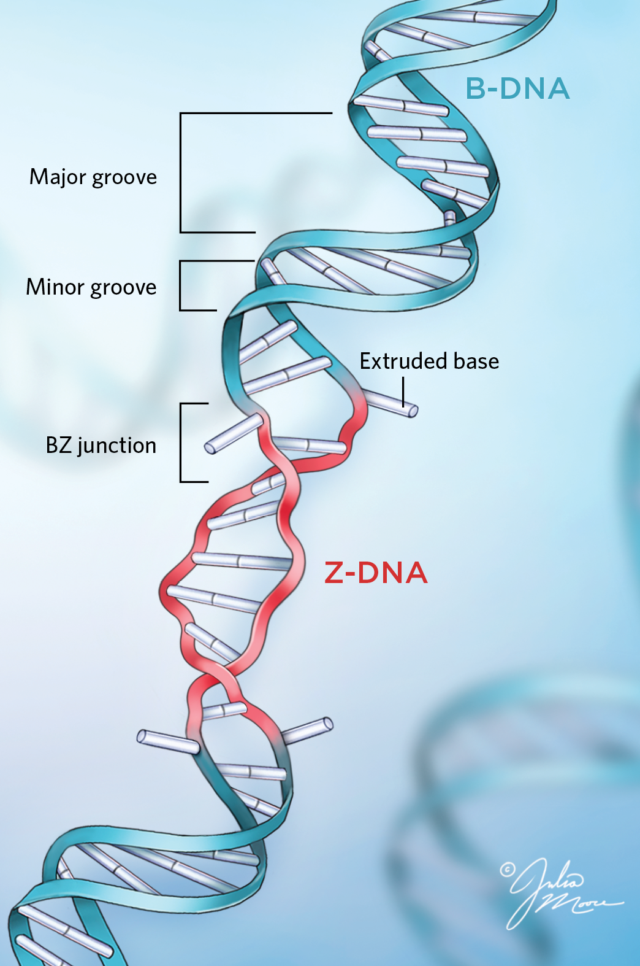

Slide 15
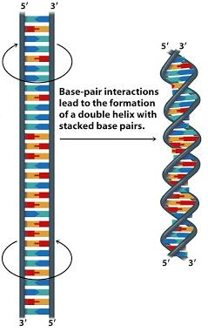

Slide 16
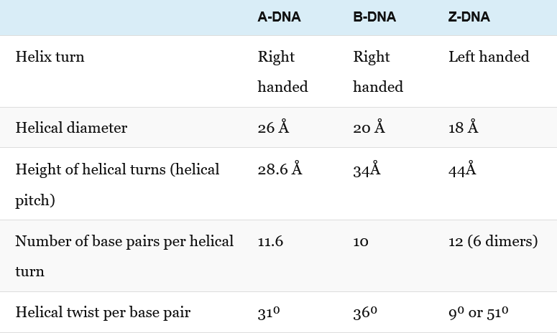
A comparison of A-DNA, B-DNA and Z-DNA

Slide 17
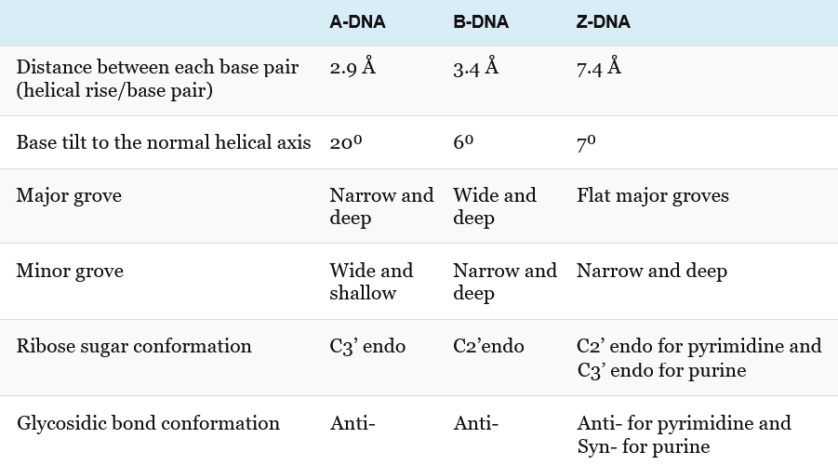
A comparison of A-DNA, B-DNA and Z-DNA

Slide 18
THANK YOU

