Slide 1
General and Molecular Genetics
Regulation of Gene Expression
(e.g. Trp Operon).
By: Shozab Seemab Khan (PhD Scholar)

Slide 2
Represive Operon (e.g., Trp Operon)
Normally on but can be turned off when the product is abundant.
Requires a corepressor molecule to stop transcription.
Example: Trp Operon (E. coli)
Regulates tryptophan biosynthesis.
When tryptophan levels are low, the operon is active, and enzymes for tryptophan synthesis are produced.
When tryptophan is abundant, it acts as a corepressor, binding to the repressor protein, activating it, and blocking transcription to prevent excess tryptophan production.

Slide 3
Tryptophan (Trp) Operon
The tryptophan operon is the regulation of transcription of the gene responsible for biosynthesis of tryptophan.
The tryptophan (trp) operon contains five structural genes encoding enzymes for tryptophan biosynthesis with an upstream trp promoter (Ptrp) and trp operator sequence (Otrp).
The trp operator region partly overlaps the trp promoter.
The operon is regulated such that transcription occurs only when tryptophan in the cell is in short supply.

Slide 4
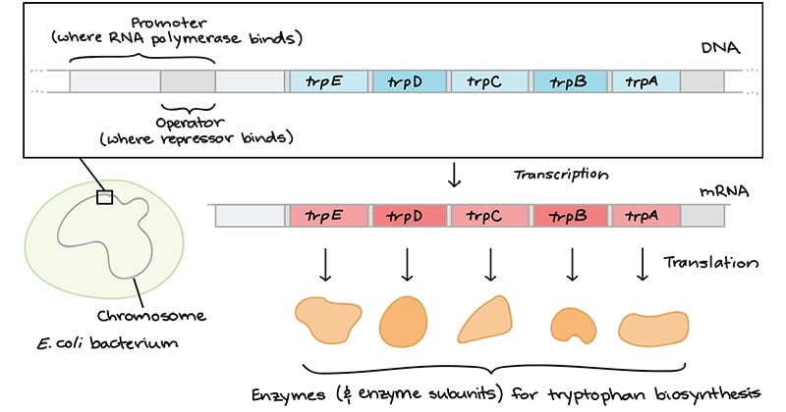

Slide 5
Structural genes of Tryptophan (Trp) Operon
1. trpE: It enodes the enzyme Anthranilate synthase
2. trpD: It encodes the enzyme Anthranilate phosphoribosyl transferase
3. trpC: It encodes the enzyme N-5’-Phosphoribosyl anthranilate isomerase and Indole-3-glycerolphosphate synthase
4. trpB: It encodes the enzyme tryptophan synthase-B sub unit
5. trpA: It encode the enzyme tryptophan synthase-A sub unit

Slide 6
In the Presence of Tryptophan
When tryptophan is present, the enzymes for tryptophan biosynthesis are not needed and so expression of these genes is turned off.
This is achieved by tryptophan binding to the repressor to activate it so that it now binds to the operator and stops transcription of the structural genes.
Binding of repressor protein to operator overlaps the promoter, so RNA polymerase cannot bind to the prometer. Hence transcription is halted.
In this role, tryptophan is said to be a co-repressor. This is negative control, because the bound repressor prevents transcription.

Slide 7
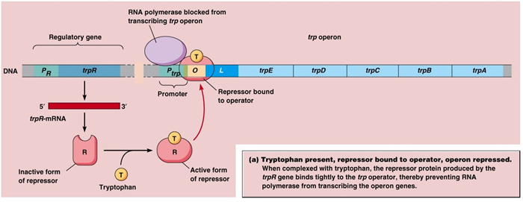

Slide 8
In the Absence of Tryptophan
In the absence of tryptophan, a trp repressor protein encoded by a separate operon, trpR, is synthesized and forms a dimer.
However, this is inactive and so is unable to bind to the trp operator and the structural genes of the trp operon are transcribed.

Slide 9
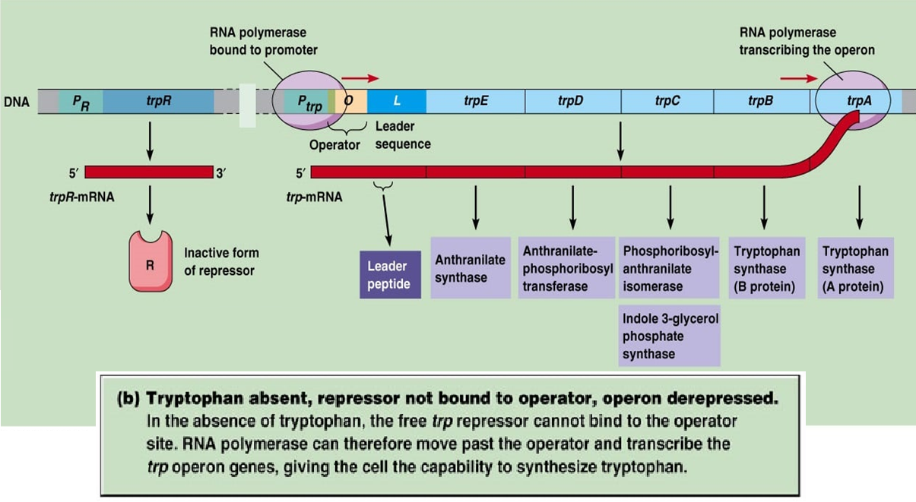

Slide 10
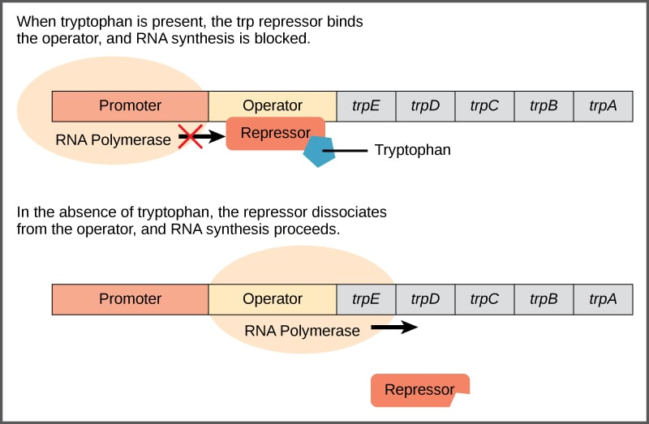

Slide 11
Summary
High levels of tryptophan in the cell shut down the expression of the trp operon. This makes sense, since high levels of tryptophan mean that the cell does not need to make more biosynthetic enzymes to produce additional tryptophan.
During low level of tryptophan or when tryptophan is absent in cell, trp operon works normally and synthesize all enzyme required for the synthesis of Tryptophan so its level in cell can be increased.

Slide 12
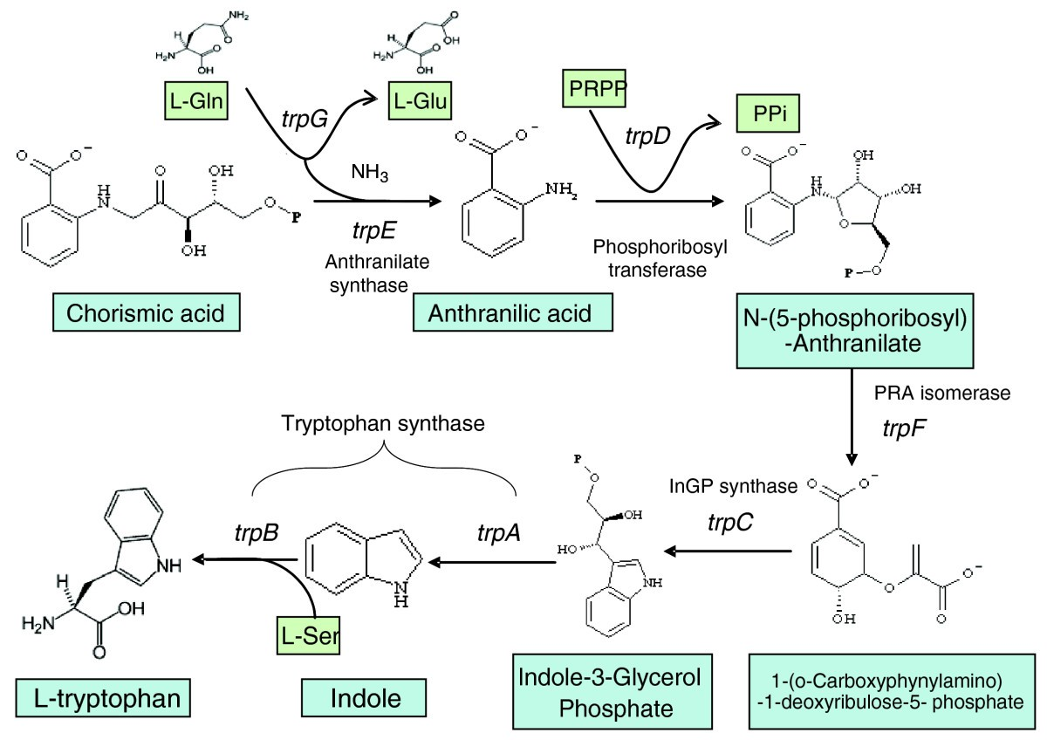
Notes:
PRPP: Phosphoribosyl pyrophosphate, Ppi: Pyrophosphate, L-Gln: (Levorotatory) L-Glutamine

Slide 13


